Slide 1
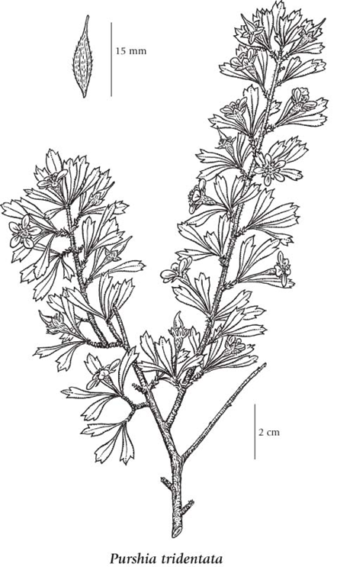
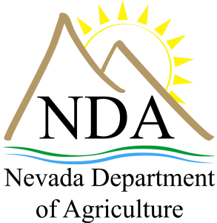
Path to Native Seed Certification:
Developing Quality Cultivars
Nevada Native Seed Forum 2018
Russell Wilhelm
Seed Program Manager
May 22, 2018

Slide 2
Seed Certification: NDA Overview
Department of Agriculture’s Role
  Official Seed Certifying Agency for State of Nevada.
  Authorized through state statute to conduct quality assurance services related to seed commerce.
    Nevada Revised Statute (NRS) 587
    Nevada Administrative Code (NAC) 587
  Association of Official Seed Certifying Agencies (AOSCA) Accredited
    “Yellow Book”

Slide 3
Certified Seed: Defined
Officially recognized seed that has been determined to possess stable characteristics relating to:
  Purity
    The ability for a seed crop to possess little to no contaminants
      Examples: Weeds, off-types, other crops, etc.
  Identity
    The ability for a seed crop to maintain its varietal features from one generation to the next.
      Examples: Physiology, resistance, vigor, viability, adaptability, etc.

Slide 4
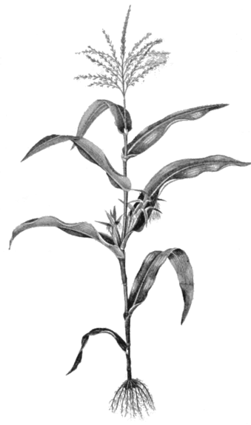
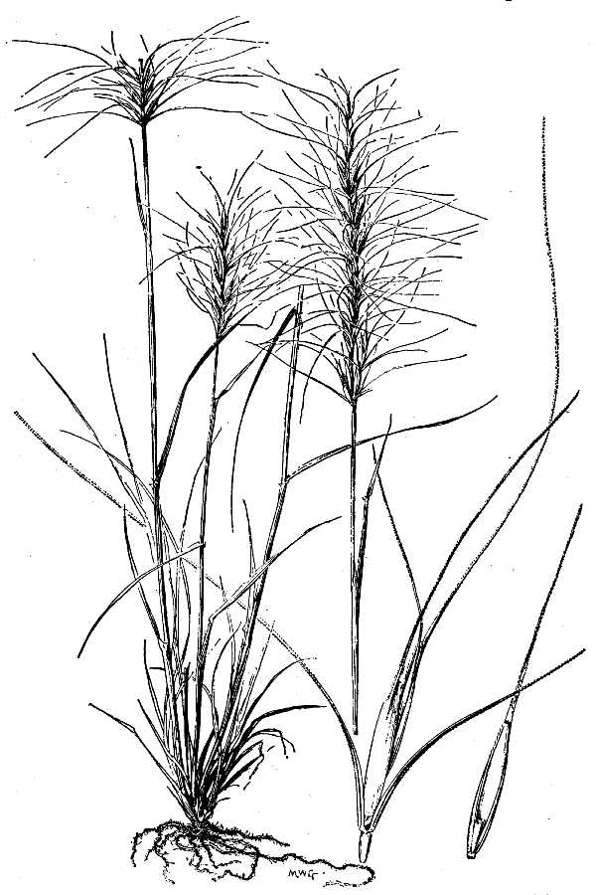
Pathway to Certification
Cultivated
  Breeder*
  Foundation
  Registered
  Certified
Natural
  Source ID
  Selected
  Tested
  Cultivar*
*Breeder seed is the original source of all classes of certified seed. It is controlled by the original plant breeder, or institution, to ensure maintenance for genetic purity and identity.
*Cultivars are developed after stringent rounds of testing to determine the species is genetically stable and pure. Cultivars should consistently exhibit secure characteristics from one generation to the next.

Slide 5
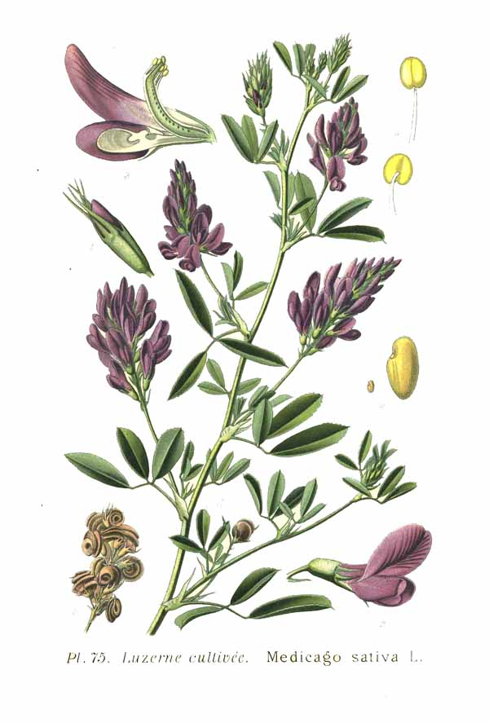
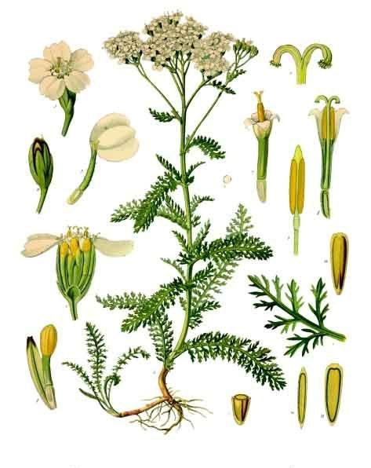
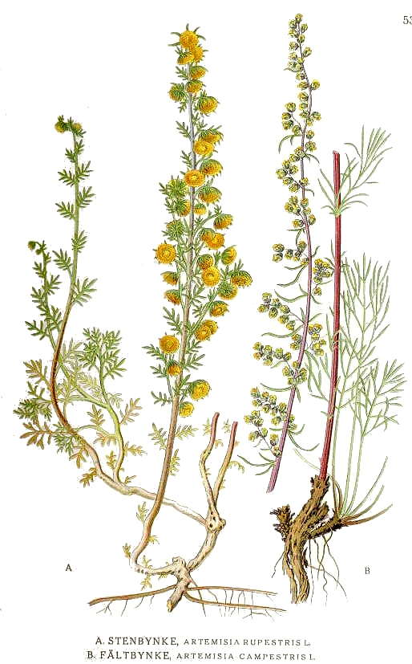
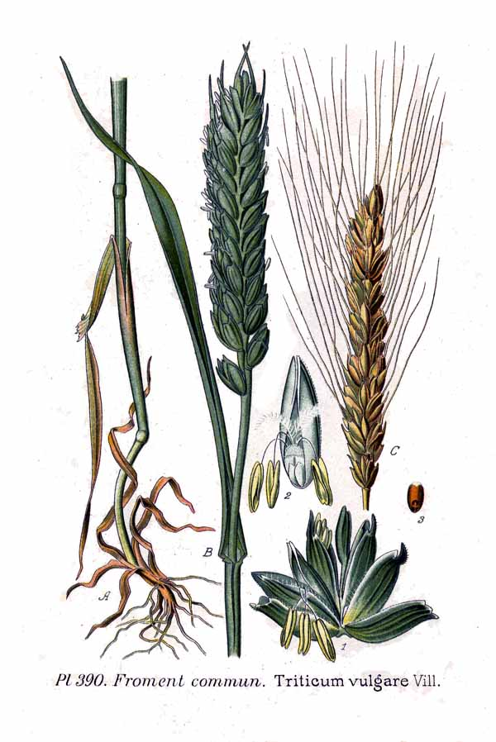
Track Distinction and Relations

Slide 6
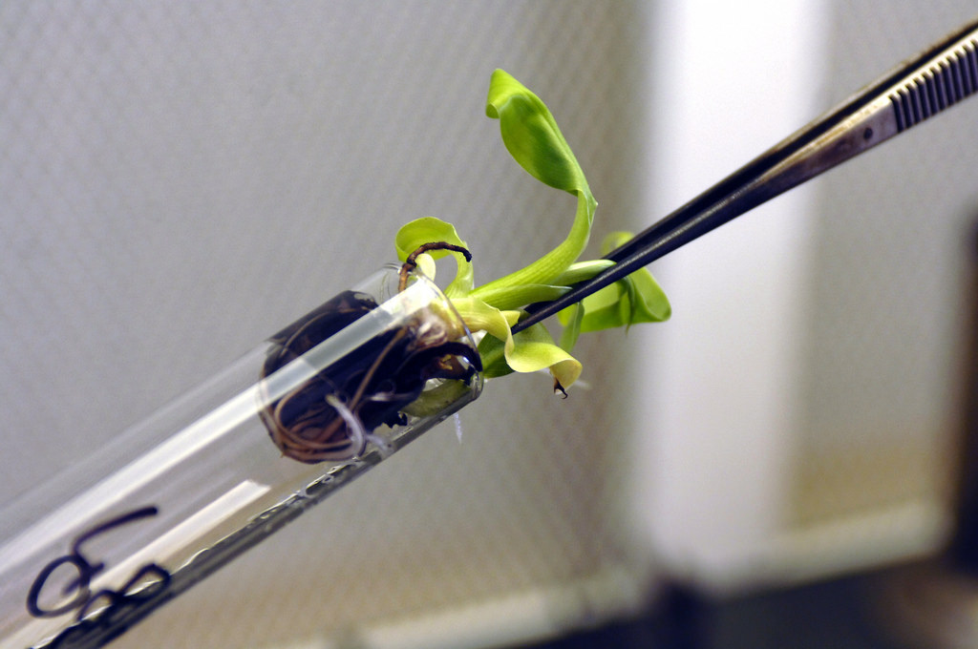
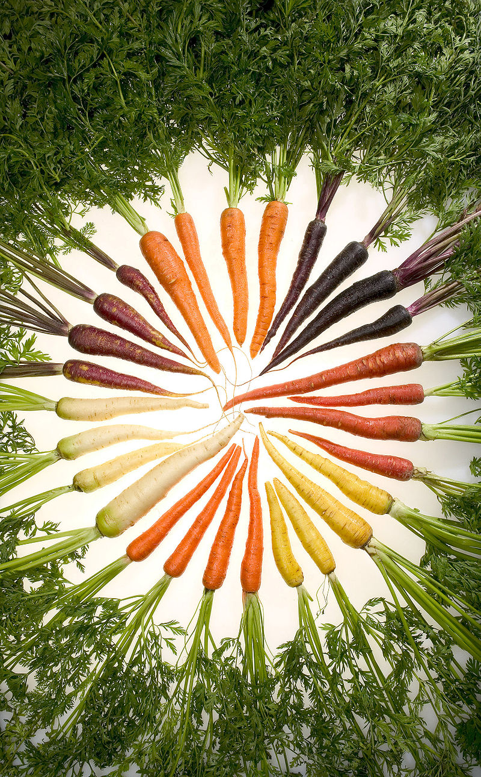
Cultivated Certification: Track 1
Cultivated (Manipulated) Track
  Traditionally reserved for agricultural commodities
    Alfalfa, small grains, corn, potatoes, etc.
  Begins with the BREEDER
    After intensive rounds of breeding and trait selection, varieties are selected and admitted to a Varietal Review Board (VRB)
    If designated as an officially recognized breeder seed, the track to certification can begin.
    Breeder → Foundation → Registered → Certified

Slide 7

Certified Seed Standards: AOSCA
The Association of Official Seed Certifying Agencies
  “Yellow Book”
    Develops standards pursuant to each “crop” type and designation.
      Standards relate to overall crop quality:
        Off-type presence
        Weed presence
        Pathogenic infection
        Lot purity/viability

Slide 8
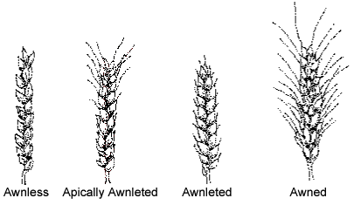
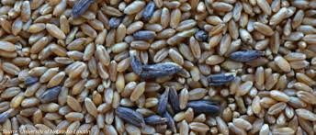
Field/Lot Standards: Crop Example
Small grain standards pursuant to class designation
NAC 587.288
Standards for Classes of Small Grains: Lot
Factor | Foundation | Registered | Certified
Pure Seed (Min) | 98.00% | 98.00% | 98.00%
Other Crop (Max) | None | 0.03% | 0.05%
Other Small Grain (Max) | None | 2/lb. | 2/lb.
Weed Seed (Max) | 0.01% | 0.01% | 0.03%
Noxious Seed (Max) | None | None | None
Objectionable Seed (Max) | None | None | None
Inert Matter (Max) | 2.00% | 2.00% | 2.00%
Ergot (Max) | 0.05% | 0.05% | 0.05%
Germination (Min) | 85.00% | 85.00% | 85.00%
NAC 587.286
Maximum Permitted in Each Class of Small Grain: Field (Ratio Of Plants)
Factor | Foundation | Registered | Certified
Other Varieties | None | 1:5,000 | 1:2,000
Other Small Grains | None | 1:10,000 | 1:3,000
Wild Oats | None | 1:10,000 | 1:3,000
Smut | 1:10,000 | 1:10,000 | 1:1,000

Slide 9
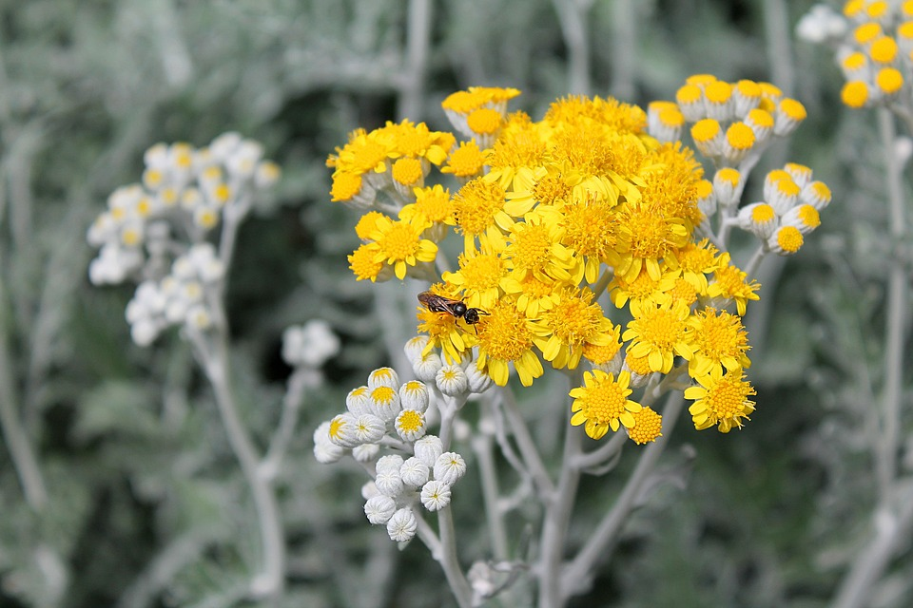
Natural Certification: Track 2
Natural Track Certification
  Traditionally reserved for wildland collected, restoration species
  Begins with SOURCE IDENTIFIED designation
    Source Identification (ID):
      Class of propagating materials collected from natural stands, seed production areas, seed fields, or orchards where no selection or testing of the parent population has been conducted.

Slide 10
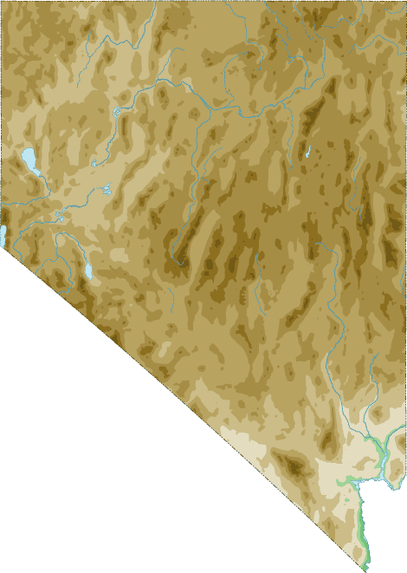
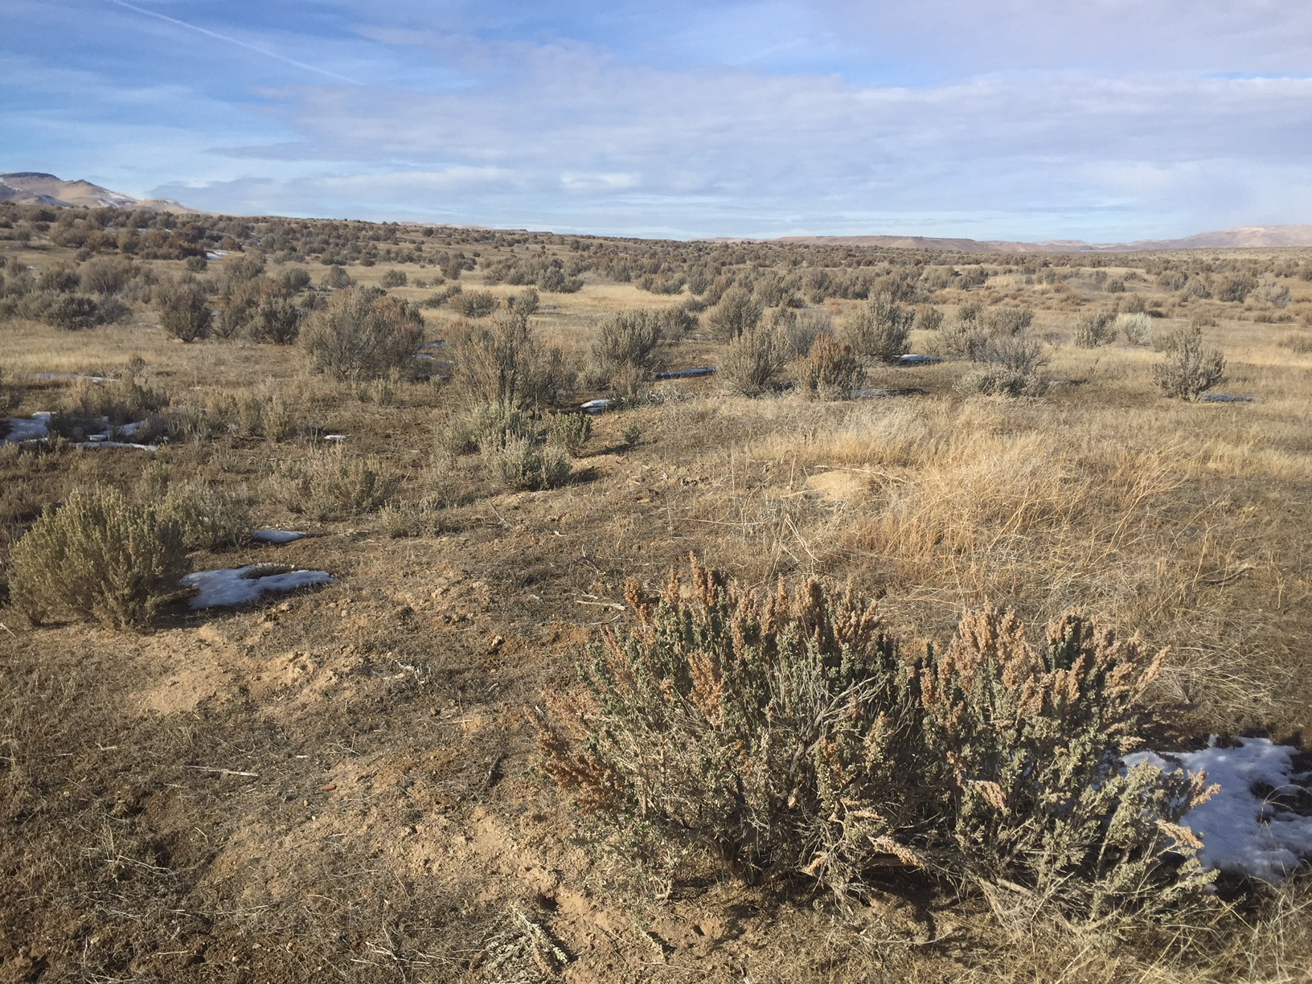
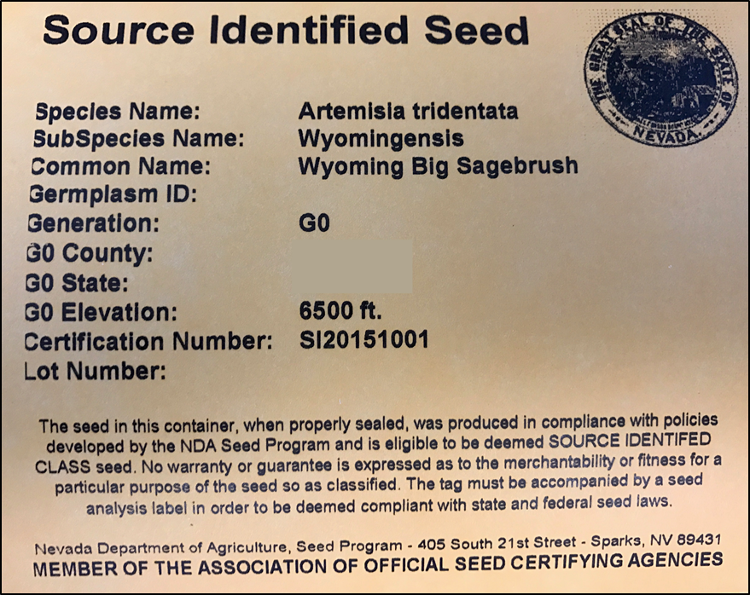
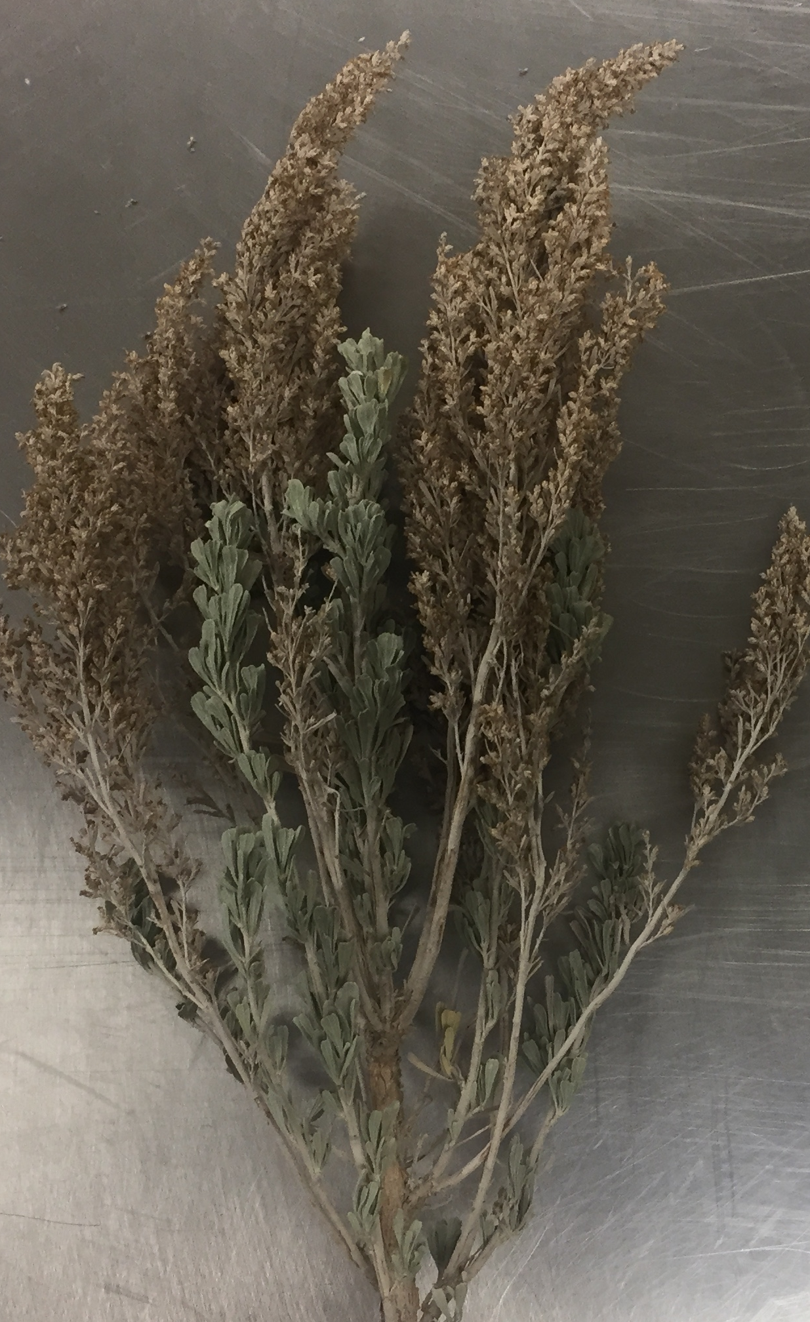
Source Identification: Benefits
Source ID is an optional quality assurance measure that can be applied to wildland seed.

Slide 11
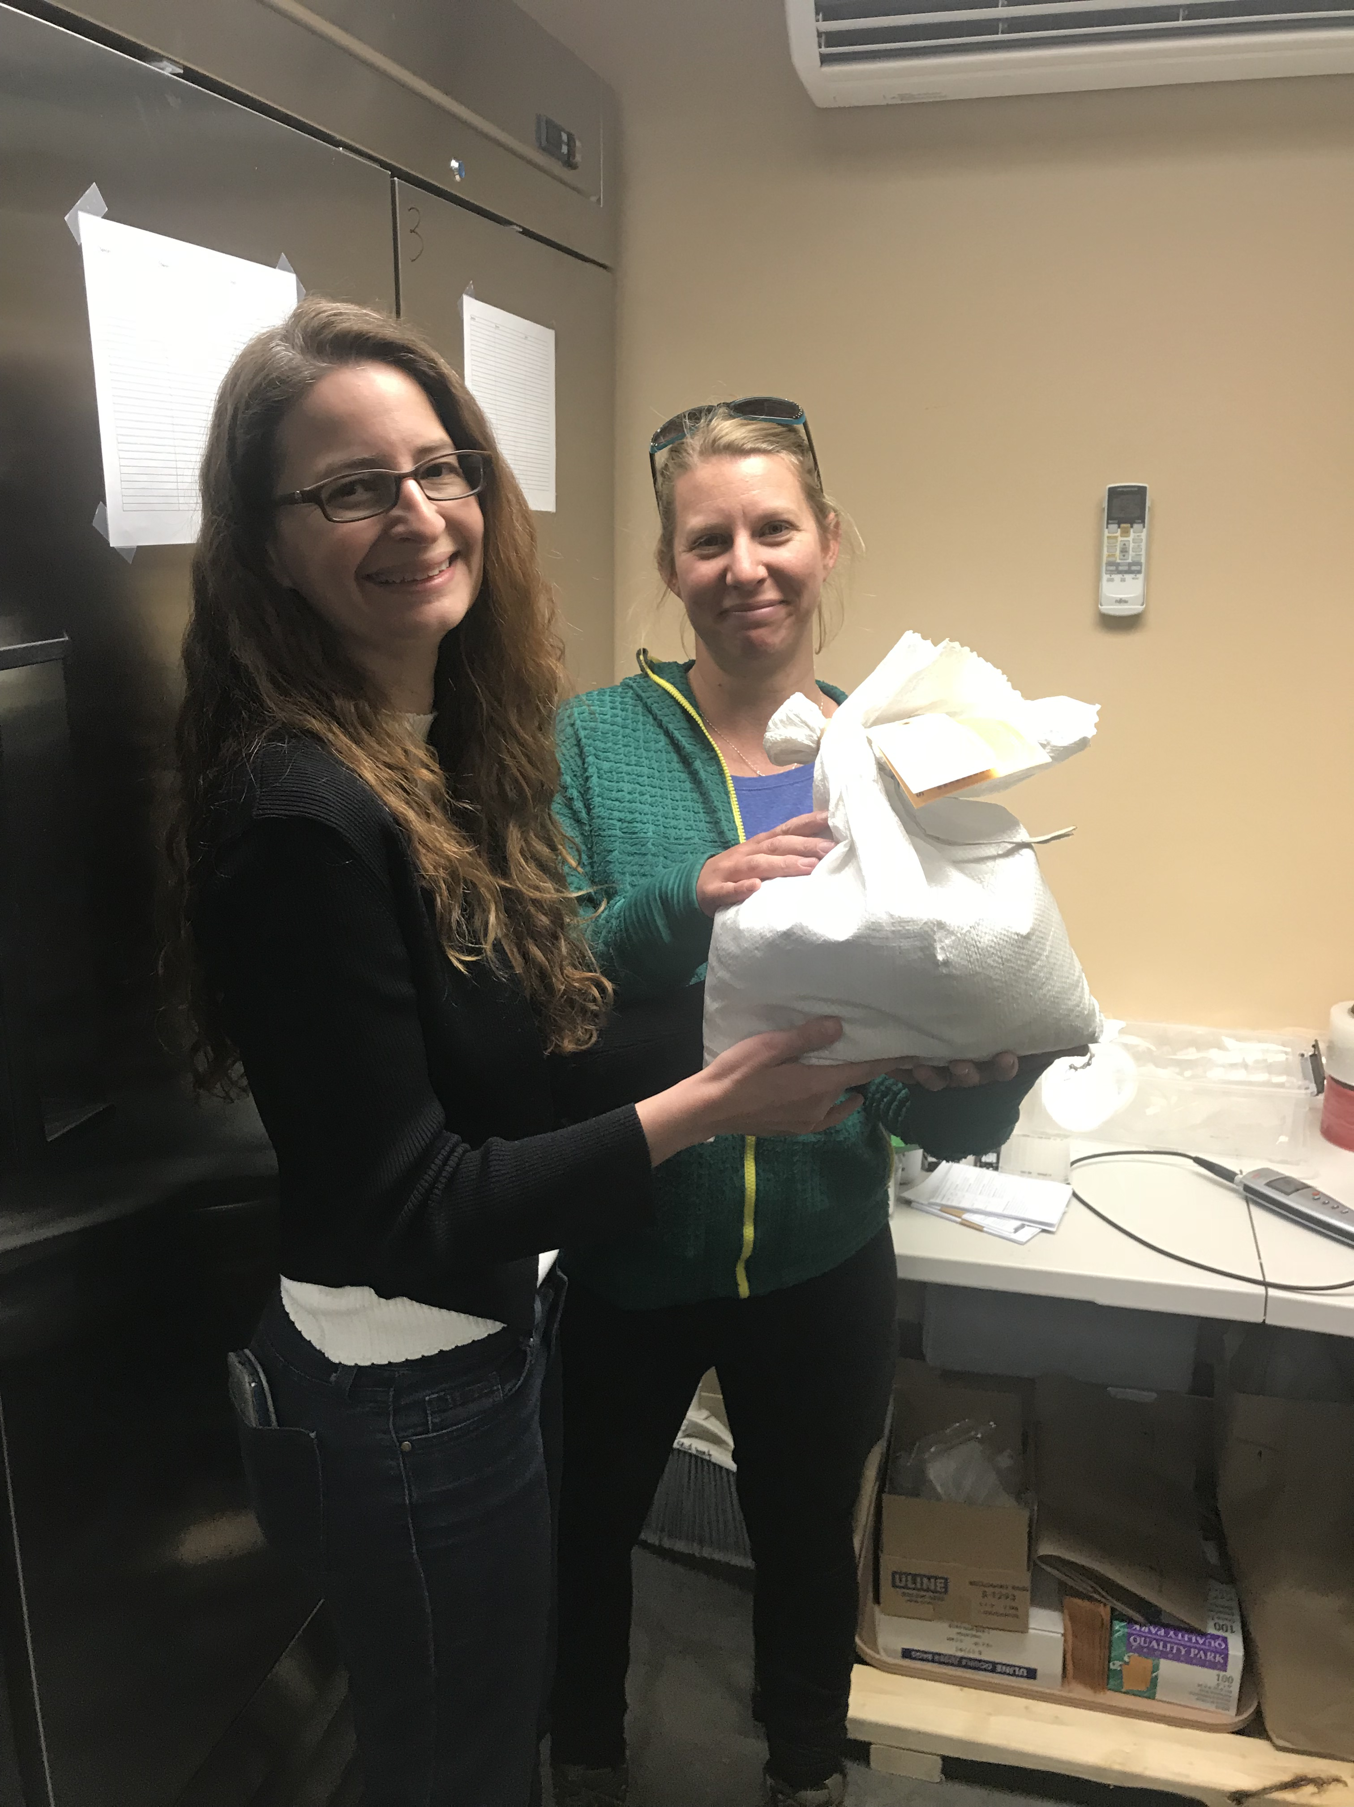
Source Identification: Purpose
Source Identified Assurance:
  Quality
    Inspections guarantee stand integrity and seed presence/maturity.
  Purity
    Lab analysis verifies cleanliness and viability of seed for buyer security.
  Identity
    ID is conducted by a non-bias third party to ensure species exactness.
  Traceability
    Tags are issued based upon clean lot yields. Each lot is associated with a certification number linking back to collection date and inspection data.
  Ecology
    Data is collected during each inspection related to the ecological attributes of the site that will assist the buyer in selecting seed specific to each, unique, job type.

Slide 12
Source Identification - How
NDA’s Guide to a Successful Source ID:
  1) File an application* with NDA prior to collection;
  2) Ensure that collection crew is present at time of inspection (not necessary, but recommended);
  3) Communication is key – inform us regarding any site changes and provide a thorough line of documentation for each collection site;
  4) Provide precise information regarding site coordinates;
  5) Collect a voucher for record keeping;
  6) Update NDA on quantities collected to order the appropriate amount of tags.

Slide 13
Natural Track: Class Progression
Source Identified (PVG)
  Must have had no selection or testing of their parent population.
Selected (PVG)
  The progeny of phenotypically selected plants of untested parentage that indicate, but do not prove, genetic superiority or distinctive traits.
Tested (PVG)
  The progeny of plants whose parentage has been tested and has proven genetic superiority or possesses distinctive traits for which the heritability is stable, but for which a variety has not been recognized.
Cultivar (For admittance within the Cultivated/Manipulated Track)
  A plant variety that has been produced via selective breeding techniques and consistently exhibits desired characteristics.
    Ie. Eagle Western Yarrow / Magnar Basin Wildrye
PVG: Pre-Varietal Germplasm

Slide 14
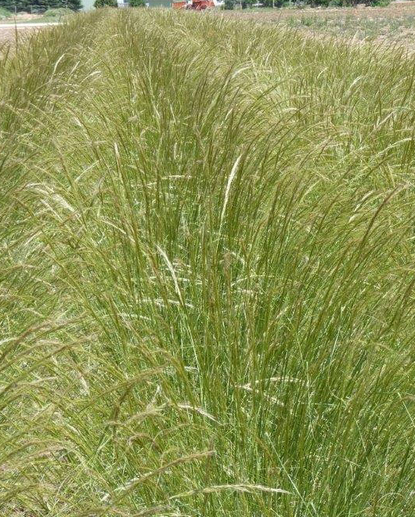
Natural Track: Class Distinction
Source Identified (g₀)
Selected
Tested
P₁
P₃
P₁
P₁
P₁
P₂
P₃
P₁
P₁
P₁
P₁
P₂
P₁
P₁
P₁
P₂
P₁
P₁
P₁
P₁

Slide 15
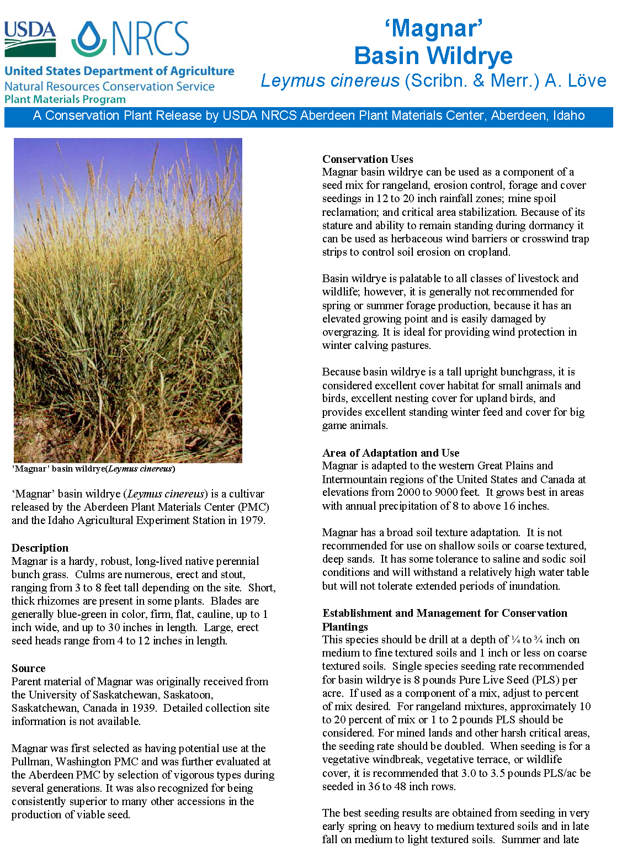
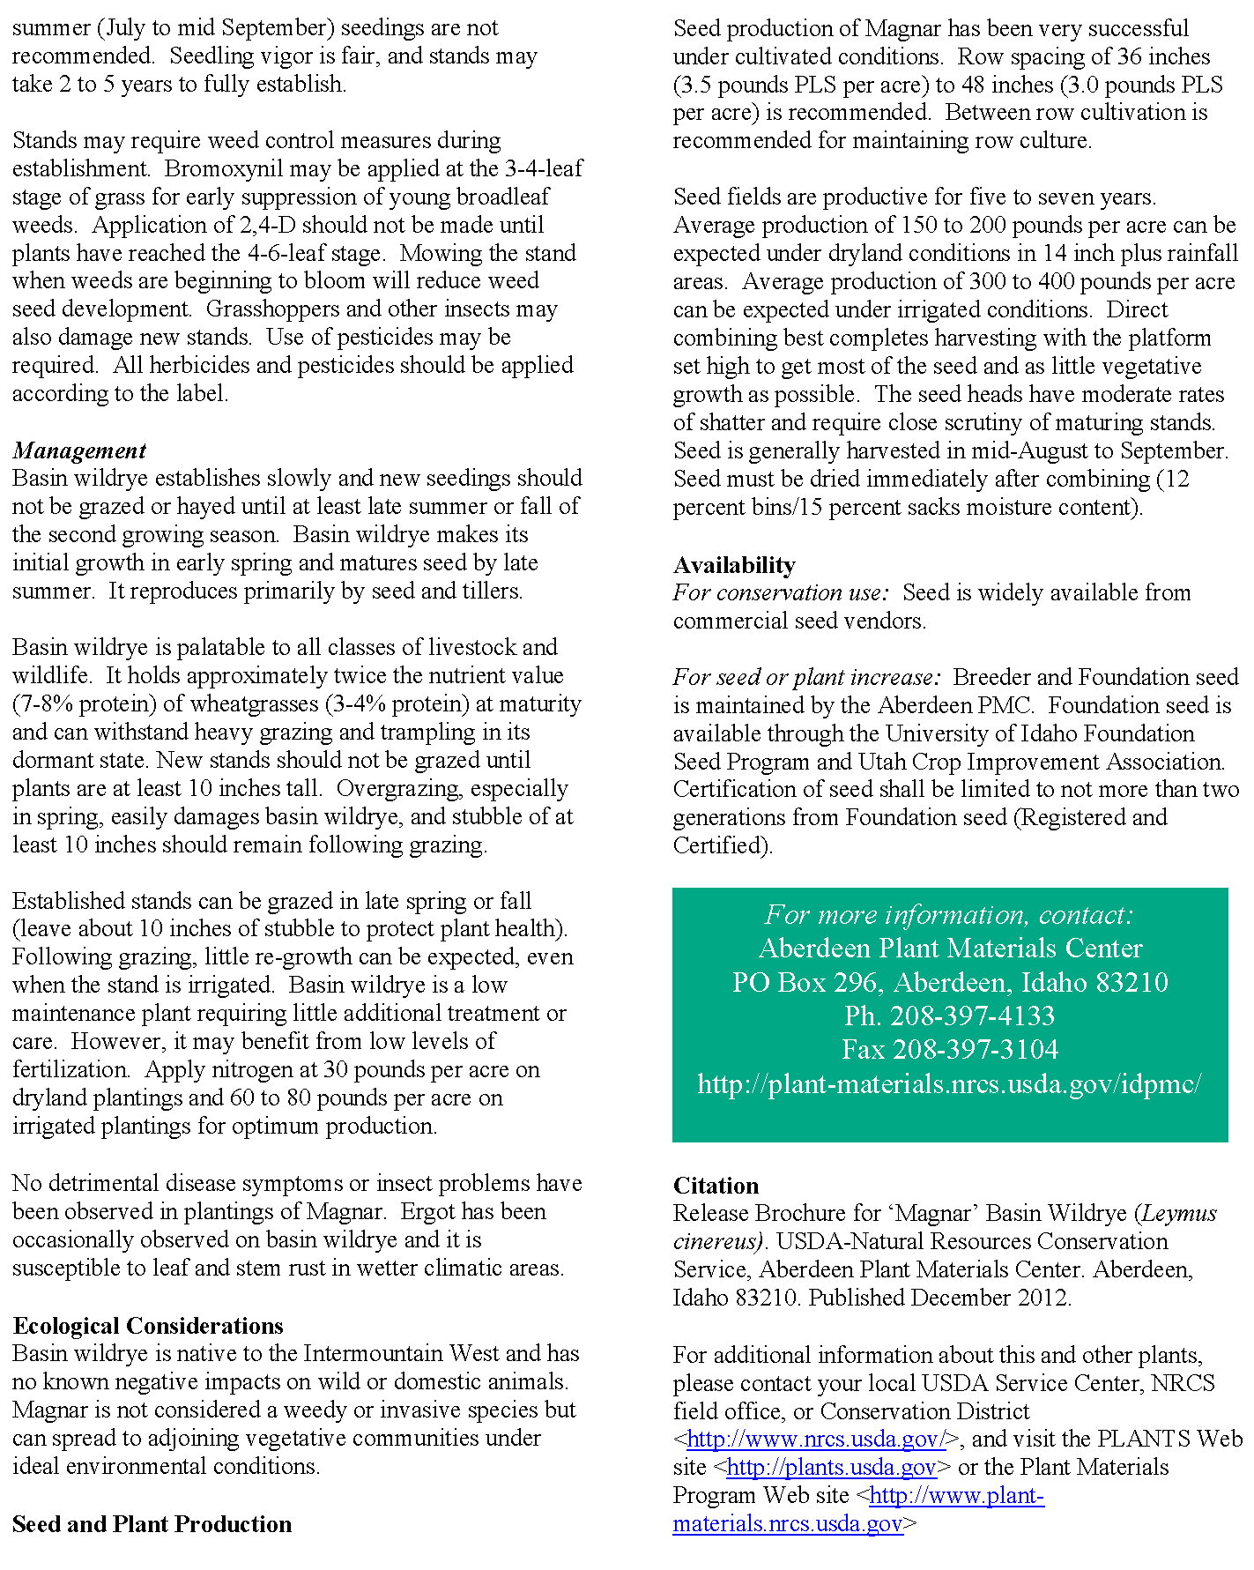
Cultivar (Variety): Characteristics
Varietal Descriptors:
Plant Description (1)
Source (2)
Conservation Uses (3)
Area of Adaptation (4)
Establishment (5)
Management (6)
Ecological Considerations (7)
Seed Production (8)
Availability (9)
3
6
9
4
1
5
2
7
8

Slide 16
Finding Common Ground…Two Paradigms
Harvestability
Viability/Vigor
Yield Increase
Stability/Purity
Distinct/Uniform
Ecologically Pure
Local Adaptation
Increases possibility of success
Unmanipulated
Ecotypic Variation
Cultivated
Natural

Slide 17
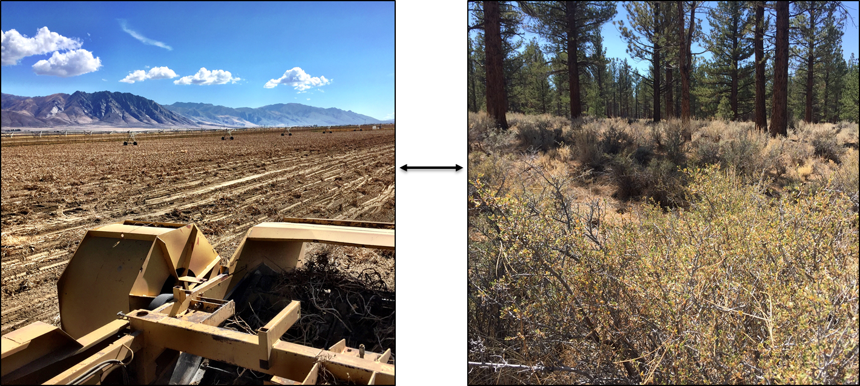
Nevada’s Industry – The Need for Seed
Linking Pre-Varietal Germplasm to Controlled Crop Production.

Slide 18
Identifying Problems…Devising Solutions
Problems:
Lack of Nevada-Sourced Seed within the Market
Impending threat of invasive species, ie. Fuel for fire
Deficit of high quality species for restoration/revegetation efforts
Market uncertainty – Supply/Demand instability
Insufficiency of native seed production
Solutions:
Encourage collection and source-identification of Nevada native species by offering incentives
Circumvent invasive issues by upgrading restoration efforts by making native seed more available
Identify superior species with higher degrees of establishment through resources such as Federal/state/local agencies
Install market stabilizers that will stimulate an equilibrium between supply/demand
Develop higher quality cultivars that will assist in production ease and desire.

Slide 19
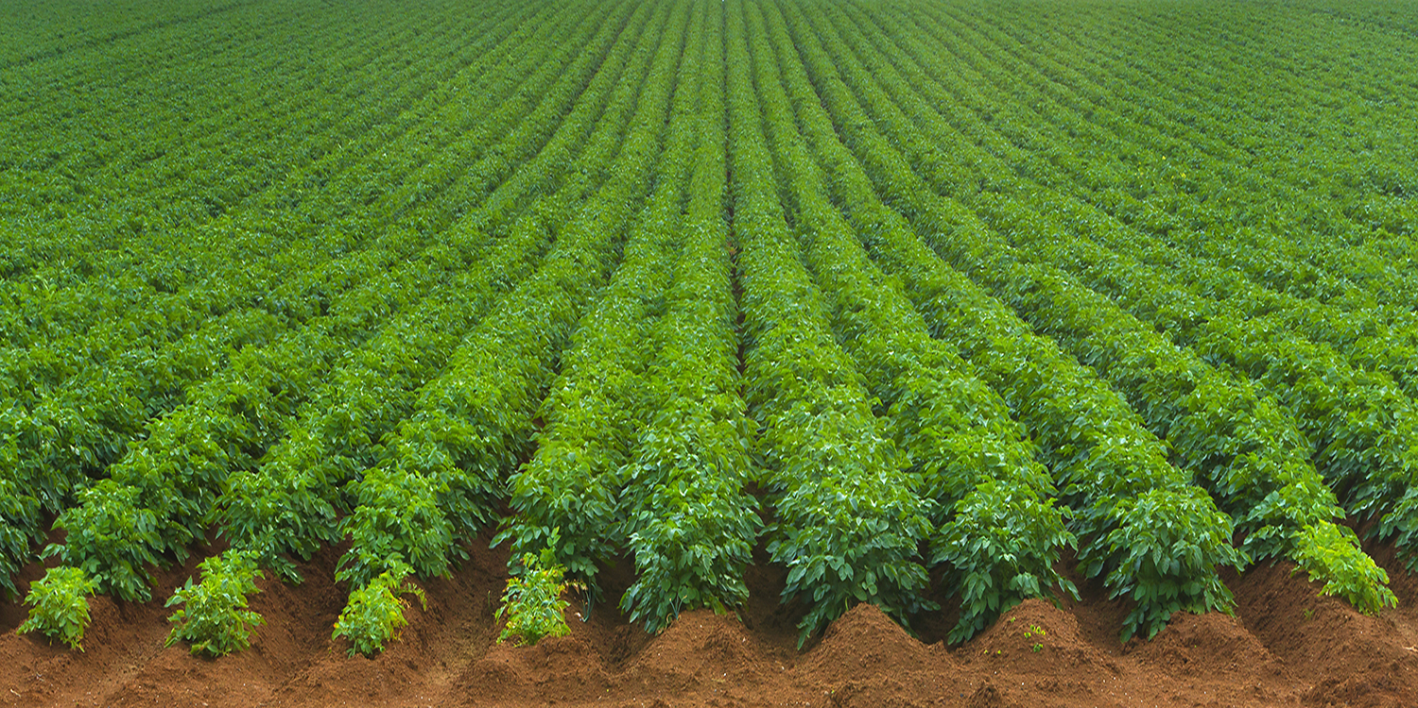
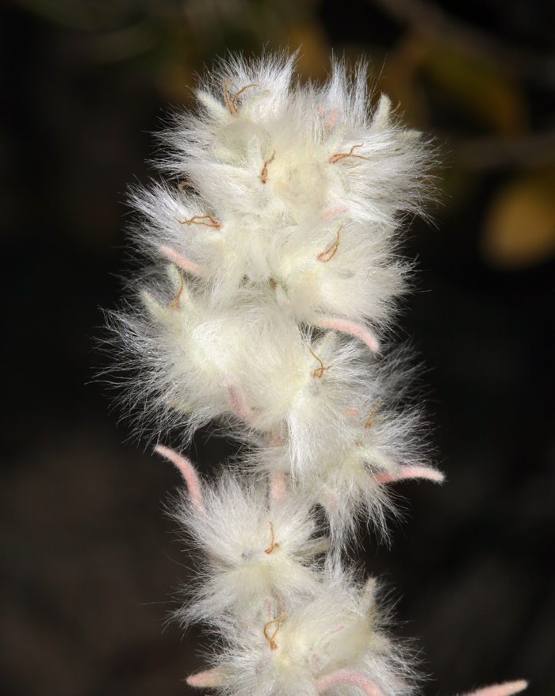
Questions?
Russell Wilhelm
Email: rwilhelm@agri.nv.gov
Office: (775) 353-3711
Mobile: (775) 750-5910

