Slide 1
Farm to Child Nutrition Programs
For School Garden and School Farm Champions
JuliAnna Arnett
Farm to School Lead, Western Region Office
Food and Nutrition Service
United States Department of Agriculture
04.13.19

Slide 2
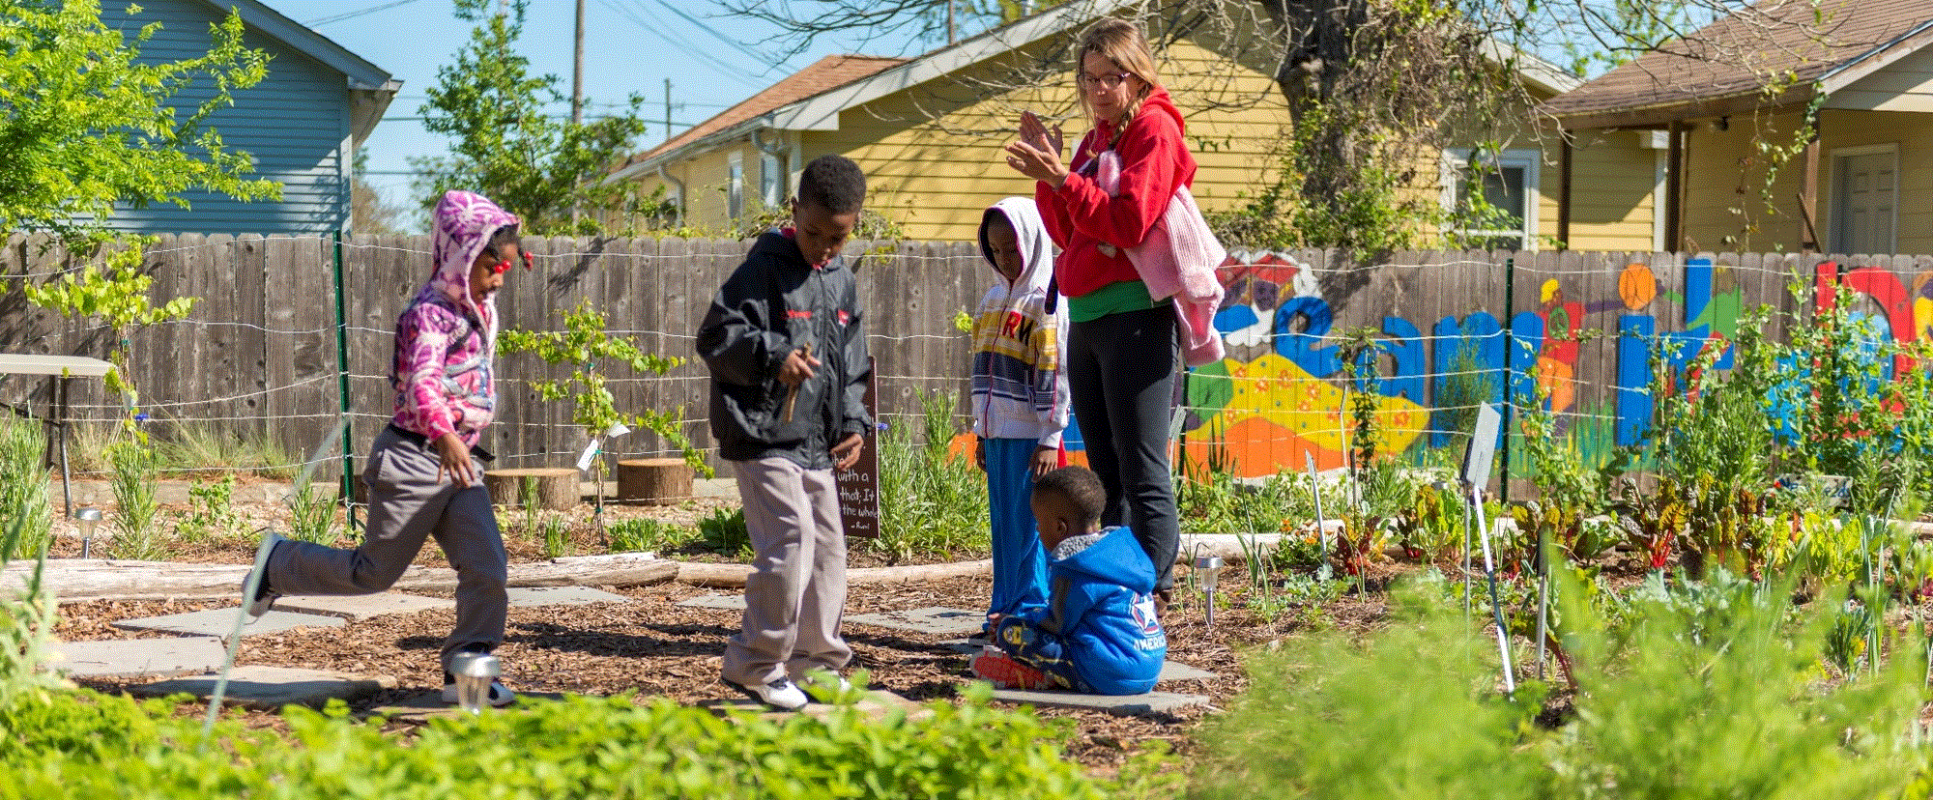
School districts responding to the 2015 USDA Farm to School Census reported a total of 7,101 school gardens across the nation. How many school gardens were on record in 1906?
Notes:
Since I’m talking to a number of teachers today, I thought that I would start with a little history…

Slide 3
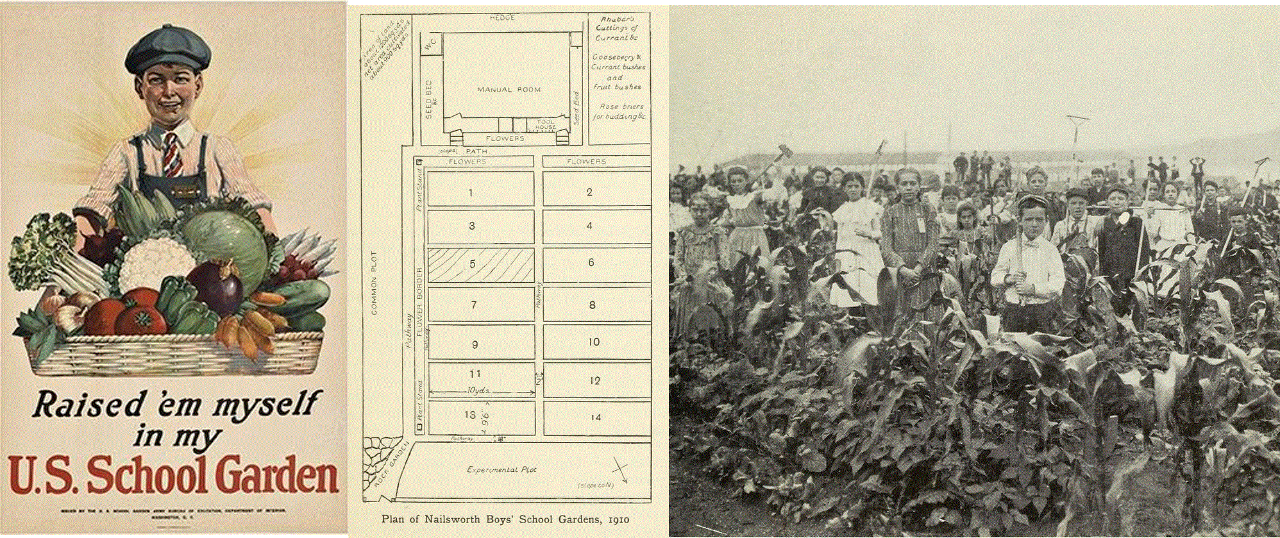
The USDA estimated there were 75,000 school gardens in the United States in 1906.
Notes:
School gardens have been growing around the country, and have been encouraged by the federal government since the early 1900’s as a way to encourage a more localized, resilient food system as a measure of national security.
School gardens predate the USDA’s National School Lunch Program! In fact, in 1906 there were 75,000 school gardens- some say that school gardens were the first child feeding program as not only were students encouraged to eat the produce but also gardens were considered essential to public education.
WWI gave school gardens another boost- tag line “A garden for every child. A child in every garden” Government support of School Gardens is not new– pre-date the National School Lunch Program
Educators wrote about the impact of school gardens on what they called “civic development, and using private hands for a public good” students ate the produce in school and brought some home with them. School gardens were supported by the US Department of Education and considered essential in teaching self sufficiency and character development. School gardens encouraged students in urban areas to start home plots.
Data source: https://nalgc.nal.usda.gov/school-garden

Slide 4
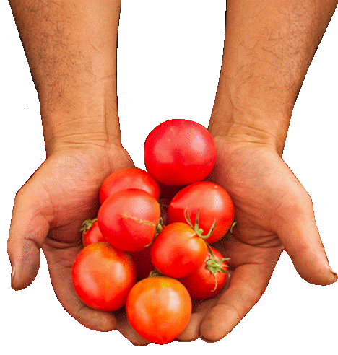
Learning Objectives
Describe USDA support for farm to school and school gardens
Identify several opportunities and models for sourcing food from school gardens/farms
Recognize resources available to support procurement from school gardens/farms

Slide 5
USDA Food and Nutrition Service Office of Community Food Systems
Section 18 of the Richard B. Russell National School Lunch Act was amended to create a Farm to School Program to:
Distribute grant funding to improve access to local foods in schools.
Provide training and technical assistance to improve access to local foods in schools.
Disseminate research and data on existing programs and opportunities for expansion.

Slide 6
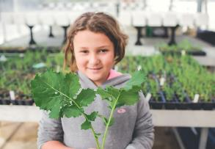
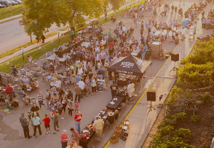
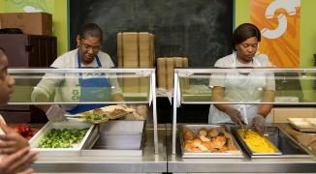
What is Farm to Child Nutrition Programs (CNP)?
Community
Classroom
Cafeteria
Notes:
What is farm to school? The term ‘farm to school’ is generally understood to include a combination of efforts that connect children with the source of their food through the hands-on education, school gardens, and serving local food in school cafeterias.
Farm to school programs can look unique in every community – in fact, communities themselves can define what their programs goals are, and what “local” means to them. We find that the most successful programs combine multiple approaches, and the most impactful programs serve local food in the cafeteria, while educating students about where their food comes from.
You may have also heard farm to school defined as procurement, education, and school gardens.
Since today’s conference is focused on school gardens and agricultural education. I will focus on procurement or the cafeteria connection, but primarily as it relates to school gardens, with the understanding that these strategies may be part of a broader, more comprehensive farm to school program.

Slide 7
Why Garden/Farm to Cafeteria?
Cafeteria
Willingness to try new foods
Increased consumption of fruits and vegetables
Provide fresh product– school garden or farm product is often competitively priced or no cost
Classroom
Improved knowledge and awareness regarding gardening, agriculture and healthy eating
Connections between the cafeteria and classroom
Community
Markets for farmers, local economic benefit
Build support Farm to School Program through job training and buy-in
Create positions: Farm to School and school garden coordinators

Slide 8
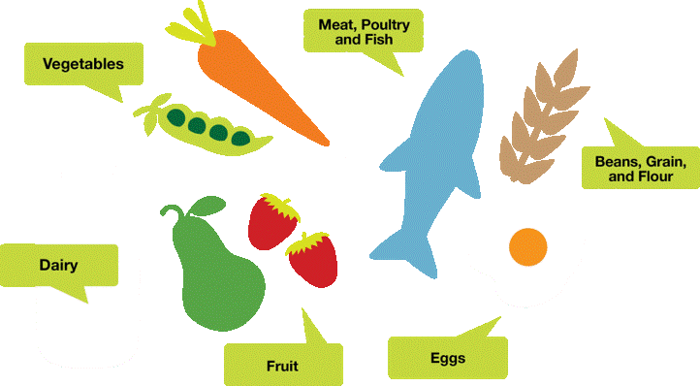
What types of products?
Notes:
Let’s discuss the types of local foods a school might source.
Local sourcing is not just about fresh fruits and vegetables, and it is not just about farmers. Local and regional foods can also include beans, grains, flour, meat, poultry, fish, condiments, herbs, eggs and dairy. Local products can come from local farmers, ranchers, fishers, food processors and distributors of all sizes.
For many school districts, fresh fruits and vegetables are a logical starting place for local procurement. Fresh fruits are especially easy because many can be served with little to no preparation beyond washing.
And then beyond local fruits and vegetables, more comprehensive local buying programs incorporate local products in all of the food categories. Many schools, for example, adjust existing recipes and menus to accommodate local products (e.g. replacing beef with local bison in Montana or barley with local rice in California). Schools will often develop entirely new recipes and menus based on local products and local food traditions.

Slide 9
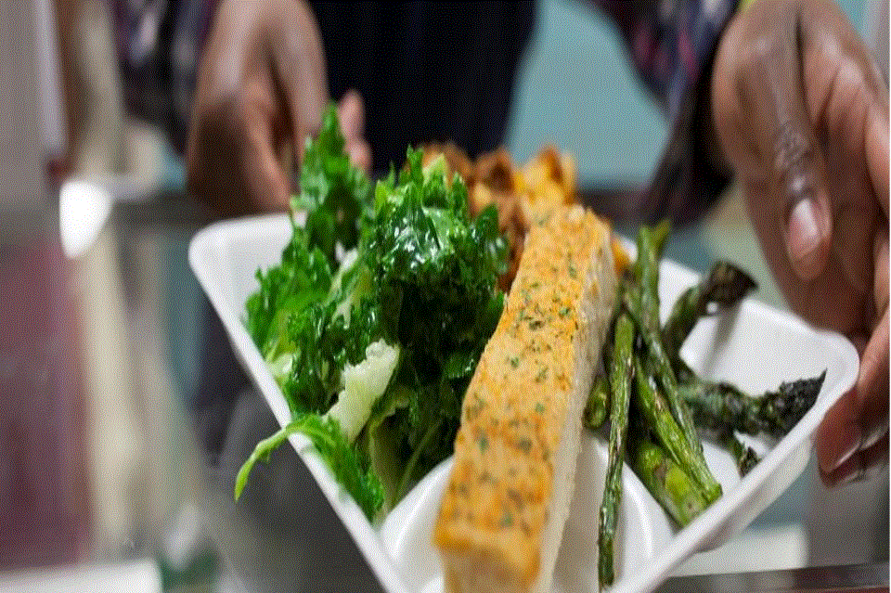
Who defines local?
SCHOOL FOOD AUTHORITIES
Or STATE AGENCY PURCHASING ON THEIR BEHALF
Notes:
It’s up to each school district to set a definition for local that works for their particular needs and goals. While oftentimes schools will adopt definitions in use by state agencies, schools can define local however they see fit.
Having specific goals for their local purchasing efforts may help an SFA craft a definition for local that serves their goals.
For example, is the SFA trying to support small producers? If so, the SFA might adopt a definition for local that includes limitations on farm size. Is the school trying to get as much local product into the school cafeteria as possible? The school might consider a fairly broad definition of local that includes surrounding states in the region. Are local livestock products abundant in your region but local fruits and vegetables scarce? An SFA could consider different definitions of local for different product types.
What SFAs define as local can frame who they purchase products from, how those products are grown and where funds go.
SFAs definition of local can evolve and change as their program does.
What are you REALLY trying to achieve? Is there state legislation regarding local purchasing? Do SFAs want farm visits and to develop personal relationships with farmers? Is it to support health? Economy? Beyond the “distance” term, what does this mean and why are they trying to source local?

Slide 10
Guiding Principles
Local or non-local product, guiding principles apply to every purchase every time.
Federal, State, and Local Regulations
Competition
(§2 CFR 200.319)
Responsive and Responsible
Buy American*
(SP 38-2017)
1
2
3
4
Notes:
These four USDA procurement principles guide the procurement process and ensure that taxpayer money is only used to procure the best products or services at the lowest possible prices.
The most important principle of a sound procurement is competition. Competition helps ensure that taxpayer dollars are used efficiently and effectively.
The regulations use the term “full and open competition,” which essentially means that all potential suppliers be on a level playing field. For more information, see 2 CFR 200.319.
The Buy American Provision requires schools to purchase domestically grown and processed foods “to the maximum extent practicable.” For processed products, 51% of ingredients must be domestically grown and the product must be processed in the U.S. Reference: §7 CFR 210.21(d), Memo SP 38-2017
School Food Authorities also follow basic steps in sourcing foods:
Plan your procurement
Draft specifications/solicitation
Notify sources of the solicitation
Document the responses.
Award/Document a purchase/contract
Manage the purchase/contract

Slide 11
What does procuring local look like?
Direct
Indirect
Farmer Cooperative or Hub
USDA Foods or DOD Fresh
Distributor
School Garden/Farm
Farmer
School
Notes:
While there are many ways to procure local, today, I’m going to focus on direct procurement.
Since I’m addressing primarily gardeners, I want to talk about how you can partner with school food services to incorporate school garden/farm product into the cafeteria.

Slide 12
USDA has no rules prohibiting school garden produce or local farm produce from being served in cafeterias.
Schools may choose their own food safety protocols and rules, and establish their own vendor requirements, in accordance with state and local regulations.
Notes:
There are no federal requirements around the food safety practices of school nutrition program vendors (other than that vendors must follow all applicable laws surrounding their businesses).
There are no federal regulations, neither procurement nor food safety ones, that prohibit schools from using garden produce in the school meal programs. Districts are encouraged to connect with their local health departments to ensure the garden meets any local food safety regulations.
Schools may choose their own food safety protocols and rules, and establish their own vendor requirements, in accordance with state and local regulations. This means that school gardens and farms may be approved sources for school meal programs, and we encourage them as such!

Slide 13
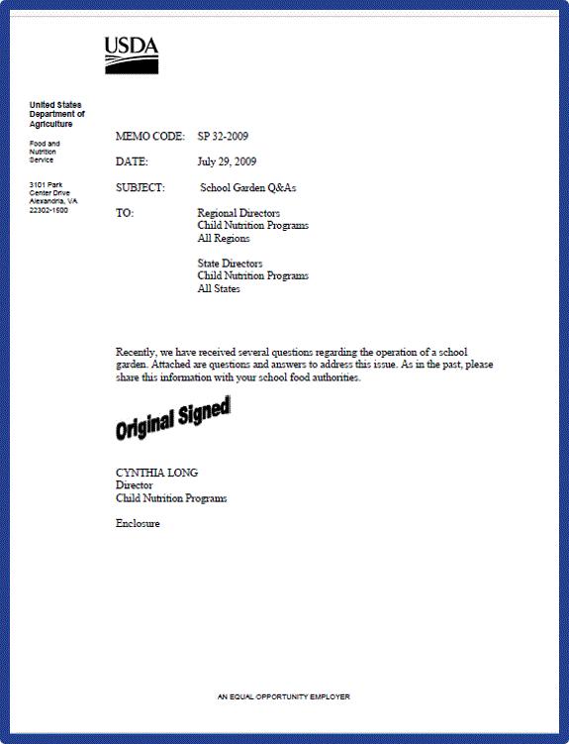
USDA Farm to School Policy Memos
School Garden Q&As (SP 32-2009)
Farm to School and School Garden Expenses (SP 06 -2015)
Procurement Geographic Preference Q&As (SP 18-2011)
Procurement Geographic Preference Q&As – Part II (SP 03-2013, CACFP 02-2013, SFSP 02-2013)
Notes:
The USDA has published two policy memos specifically addressing questions around the use of school garden grown and local foods in the school meal program AND how school meal operators can use program funds to support farm to school and school garden as long as it benefits the school meal program.

Slide 14
Garden/Farm Procurement Options
Donation
Purchase (micro-purchase, informal, formal)
Interdepartmental Agreement
Notes:
There are four main ways that schools can account for using garden produce in their cafeteria.
While school gardens do not usually produce enough food to make up a significant portion of a school meal, on-site products such as fruit, vegetables, eggs and others can supplement salad bars, be served as snacks or offered during a taste testing.
First, produce from the garden may be donated to the school meal program.
Second, the food service program can procure and pay for school garden produce, just like they would any other produce.
We want to stress that you may use funds from their Nonprofit Food Service Account to purchase school garden supplies such as seeds, tools, irrigation equipment and other such items as long as the garden is being used to provide food in the classroom or school nutrition program. Schools may NOT use funds from the Fresh Fruits and Vegetables Program (FFVP) for the purchase of any School Garden materials.
**If a school sells produce grown on their school garden, such as through a student-run farmers’ market, revenue from all sales must accrue back to the nonprofit school food service account.
Third, funds may be transferred from the food service department to the department that grew the garden produce (let’s say, FFA or the science department)

Slide 15
Donation
Procurement regulations do not apply to donated foods
Consider food safety issues and menus before accepting foods
Always document receipt of goods
Notes:
This is often the first phase in school garden to cafeteria.
Schools may receive donated foods from a variety of places.
Suppliers may donate extra produce at the end of a harvest, or the SFA may partner with a company that donates food on a specific day. Donated foods must conform to the same food safety standards as purchased products. Remember to inquire about the freshness, shelf life and refrigeration before accepting the product. The SFA should also be sure to record the amount of donated food in your accounts to ensure transparency and avoid any possible accusations of impropriety.
[The same principles apply to gleaned products. Some producers collect leftover crops after the fields have been harvested; this process is referred to as gleaning. Schools can use acceptable gleaned products at their discretion. It is recommended that schools review and document food safety practices, such as Good Agricultural Practices of producers, before accepting gleaned products. ]

Slide 16
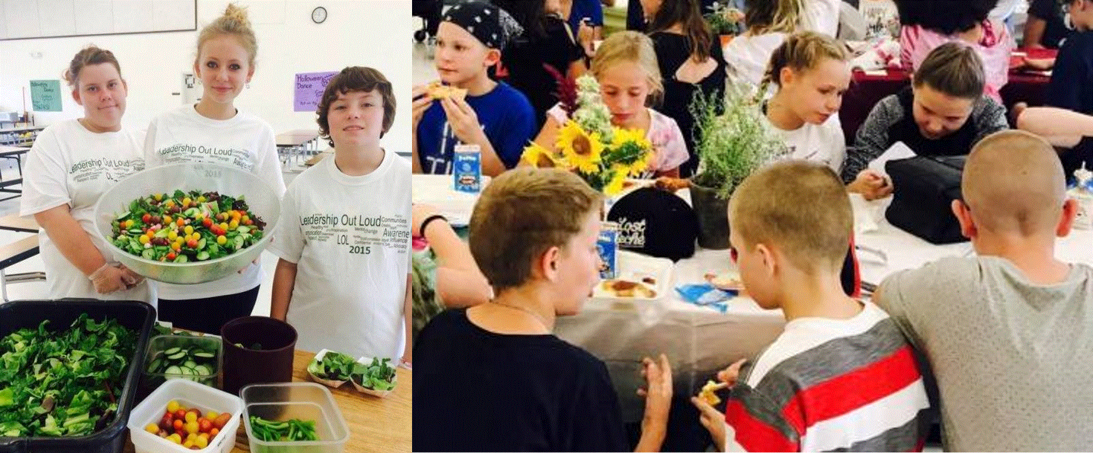
Lyons County School District, NV
https://healthycomm.org/
Notes:
Healthy Communities Coalition received a $100K USDA Farm to School Grant to partner with Lyon County School District to increase access to locally grown and minimally processed foods for the children and teens of Lyon County. The goal was to work with local producers, cooperatives, and gardeners to increase the availability of local food in the school lunch program, increase school garden production, and encourage the utilization of school garden produce in student snacks
Today, there are 8 schools gardens and hoop houses in the district. Salad bars are now located throughout the district. Foods from the gardens are used within the salad bars.
Food Service attended Edible SY training with gardeners and have gone on garden walks with garden coordinators. The more food service engagement with the garden the stronger the program.
At Silver Stage Middle School, garden to café is complimented by the site’s new family style dining program with handmade table cloths, flower centerpieces, and teachers sitting with students and initiating conversations at each table (enhancing social/emotional learning).

Slide 17
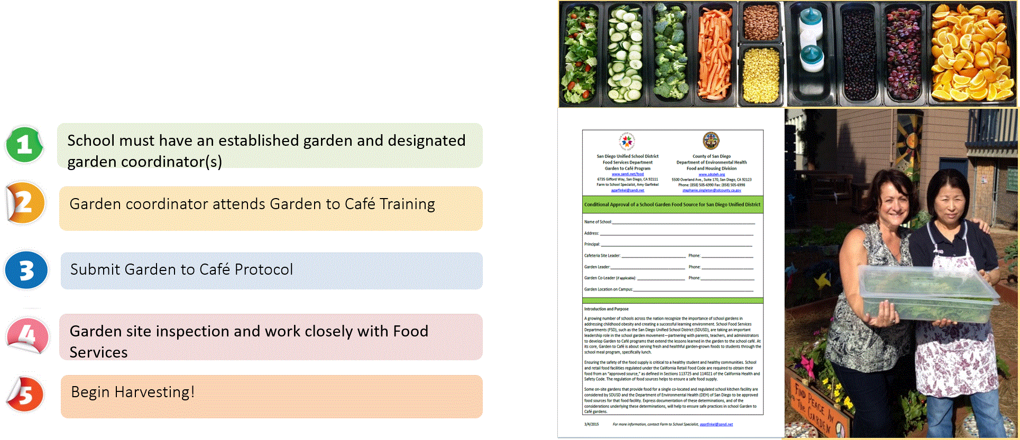
Garden to Café
San Diego Unified School District, CA
https://www.sandiegounified.org/garden-caf%C3%A9
Notes:
Why Garden to Café?
School garden sustainability is a major challenge;
Students who grow their own fruits and vegetables consume more produce
Garden to Café increases school meal participation because students are more excited to take from the school salad bar (also consumption of what they take increases so there is less plate waste)
Partnerships: Protocol developed in conjunction with County Department of Environmental Health, Coalition of NGOs and Garden Organization advisors
Process:
Program open to active gardens with a volunteer or paid coordinator. This is a partnership between food services and the school garden.
School gardener coordinators attend a Garden to Café training held 2-3 times a year. Learns about Garden to Café protocol, best practices, and resources.
School garden coordinator schedules a site visit with food service staff to walk through the culinary agreement which includes many food safety measures. Exmp.: no animals allowed in the garden, compost must be fully composted, no sick kids in the garden, no pesticides or herbicides may be used in the garden, ensure separate clean tools are used for harvesting product and delivering it to the cafeteria. They also have to have to provide a garden site map and a list of expected product.
When approved the food service, introduces them to their respective site manager. Collaboratively, they develop a schedule for when the garden will deliver them product or set-up a system that works for both the garden and food service team.
On harvest days, the students harvest garden product with clean, garden equipment kept separate from other tools. They also put it into food grade containers. They deliver it to the food service staff with a harvest receipt. They keep a copy for themselves and the school food service keep a copy on hand.
Food service then cleans and refrigerate product. It is served the Garden Grown product goes in a flex slot or slot of same product that is regularly scheduled on the salad bar.
Today, SDUSD has ~20 schools certified within the district. At the sites that have a G2C Program the cafeterias have reported more students eating from their salad bars on the days that G2C produce is served.
Note – produce from the garden can also be cooked in order to create a “kill step” that will reduce the risk of contamination even further.

Slide 18
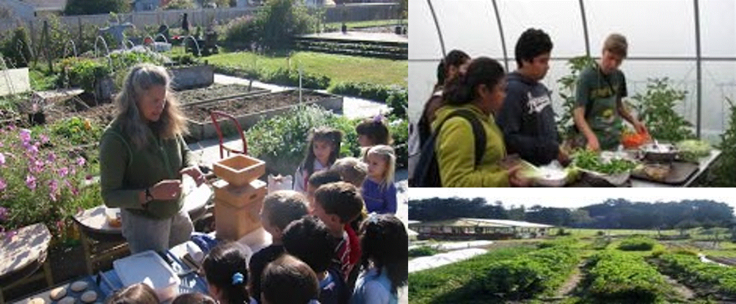
Ft. Bragg Unified School District, CA
https://sites.google.com/fbusd.us/nutrition/school-gardens
Notes:
These notes are borrowed without edits from Ft. Bragg USD’s web site:
Redwood Elementary Rainbow Farm
A school garden science and nutrition learning center serving about 500 students ranging from ages 4 – 7 years old: preschool, kindergarten, first, and second graders. Rainbow Farm provides most Redwood Elementary students with their first school gardening experiences.
Grow the Good Garden at Fort Bragg Middle School
The newest addition to Fort Bragg Schools Gardens. An outdoor classroom designed to educate middle school students to make informed choices about eating healthful, local, seasonal foods, and have pride in knowing that they are a part of a food producing community. Produce from the Grow the Good Garden is served in the Middle School cafeteria
The Learning Garden at Fort Bragg High School (a project of Noyo Food Forest)
An on-site Farm to School Program and center for education in community-based agriculture and nutrition at Fort Bragg High School. Organic food is grown by students, volunteers, and staff, sold to the FBUSD Food Service Program, and served in all school cafeterias.

Slide 19
Purchase
SFAs can procure garden produce; must follow all applicable federal, state, and local regulations
In many cases, the purchase qualifies as a micro-purchase ($10K) or small purchase ($250K)
Micro-purchase- purchase is less than $10K, reasonable, equitably distributed, and documented
Small purchase- purchase is less than $250K, SFA acquires quotes from multiple responsive and responsible vendors and documents

Slide 20
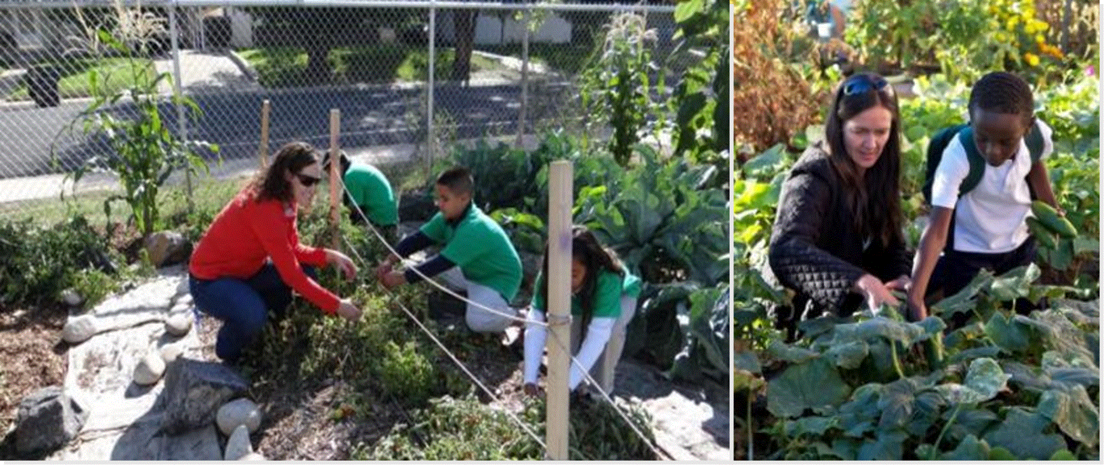
Denver Public Schools, CO
http://foodservices.dpsk12.org/farm-garden.php
Notes:
Denver School Gardens are run by Slow Food Denver, Denver Urban Gardens, the Kitchen Community and a few other non-profits.
For the past five years, DPS Food and Nutrition Services has used an informal procurement method to purchase products from the gardens – they compare garden pricing to a handful of other sources in order to get the required price quotes.
DPS also has a handful of large school farms. DPS hires a farming services contractor to grow and harvest vegetables through a formal procurement process to abide by local, state and federal regulations.
Schools can also consider a garden purchase part of their micro purchase, for purchases under $10,000. This is probably the most likely procurement option!

Slide 21
Nonprofit School Food Service Account
School Food Authorities may use nonprofit school food service accounts to cover garden and farm to school activities, if:
Farm to school activities and school garden development support the operation or improvement of the school meal program and are reasonable expenses
Funds only the portion of salary a school garden or farm to school coordinator directly spends supporting the school food service operation and deemed necessary, reasonable, and allocable for the operation of the school meal programs
Notes:
Primary purpose of the nonprofit school food service account is to operate or improve a school meals program that serves nutritious meals meeting the meal pattern requirements
School Food Authorities may use nonprofit service account, if:
Takeaway. If the farm to school activities or garden support (including nutrition education, taste tests, aiding in the procurement process, offering marketing support, supplies (seeds, fertilizer, water cans, rakes, etc.), and equipment)
Funds can also cover staff time for garden and farm to school gardeners, but only the portion of their time directly benefiting the school meal program.
SFA must also be in compliance with the National School Lunch and Breakfast Program rules and regulations and have the available funds.
FNS existing policy has been and continues to be to not approve the cost of building purchases because program funds are made available to help support the costs of nutritional benefits for children in school settings.

Slide 22
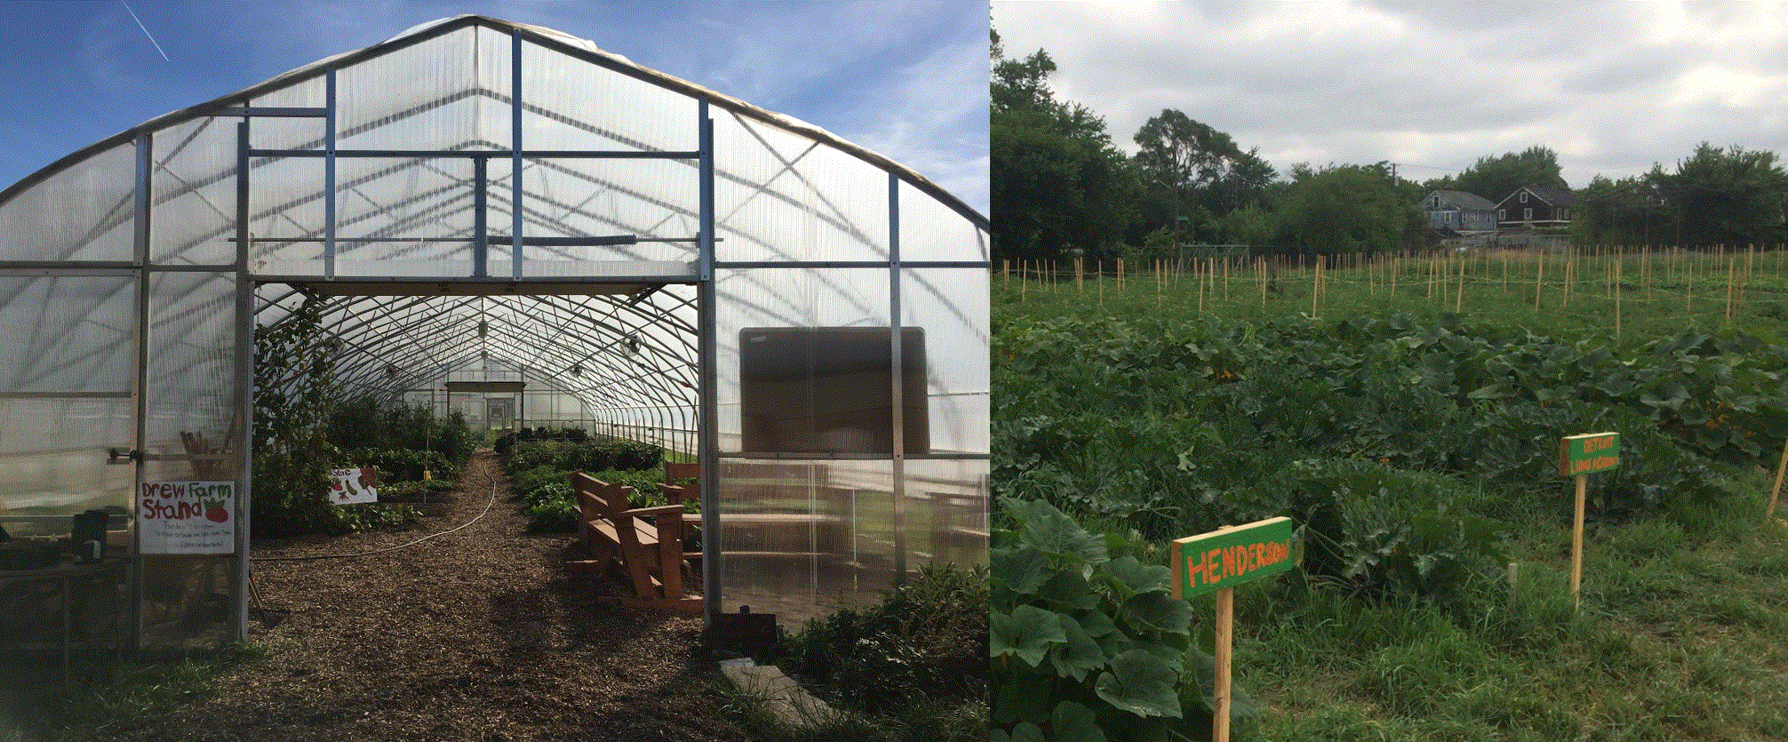
Detroit Unified Public Schools, MI
https://www.detroitk12.org/Page/7168
Notes:
Detroit Unified Public School’s Division of Food Services has actively supported 80 of school gardens across the city.
Food Services grows for food services, paying for the garden inputs directly (rather than the cost of the harvest produce).
They have lots of partners (Detroit Eastern Market, Michigan State Extension, FoodCorps, Junior Master Gardener, 4H) that support the garden development; yet, all of the produce goes to the district as the gardens are on district land and are supported by district staff.
Some of this produce is sold as school markets- with all profits going back to the NPSFS Account for reinvestment in the program.
The Division of Food Services also has a School Garden Director who serves as a menu planner for the district.
Their largest garden, Drew Farms, sits on 2.5 acres. Teachers and farm managers work with students at Drew Transition Center, a school where students with disabilities prepare for adulthood and work together to provide healthy produce to hundreds of Detroit students. Drew Farm provides approximately 20 tons of fresh produce (corn, squash, cabbage, muskmelon, cherry tomatoes, watermelon) to 15 schools in Detroit annually while also facilitating the development of valuable skills to the students at Drew Transition Center.

Slide 23
Interdepartmental Agreement
SFAs may enter into an intergovernmental agreement with the school garden or school farm to purchase products from the garden
The entity operating the school garden must be the local educational agency or another governmental entity
A price analysis must be conducted to ensure that products purchased from the garden are a reasonable price
The agreement may outline the price for the produce, relative timelines and expectations of both parties

Slide 24
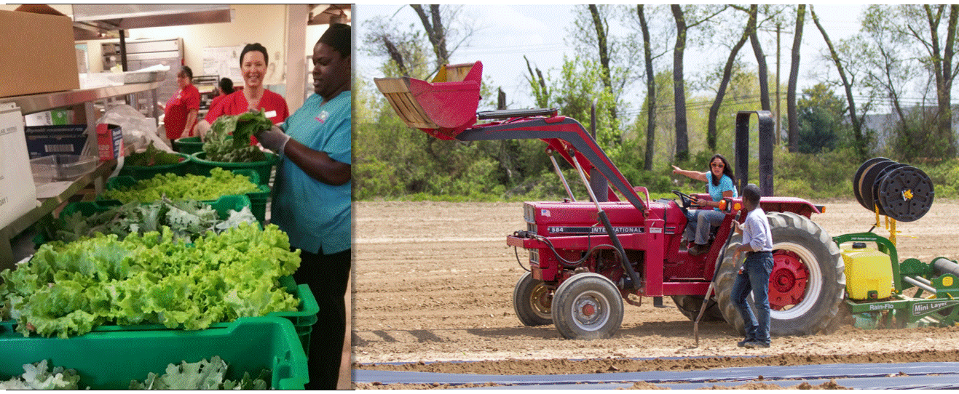
Colonial School District, DE
http://www.colonialschooldistrict.org/pennfarm/
Notes:
Serves approximately 10,000 students across eight elementary, three middle, one high, and two special needs schools.
The district cooperatively manages 4 acres of farmland at the historic Penn Farm, where high school students are integrally involved in crop production.
An interdepartmental agreement between division of food services and (FFA) horticulture and vocational-tech department. Nutrition staff coordinated with the high school agriculture teachers, students, and the Penn Farm manager to incorporate food from the farm in their meals as often as possible.
The food service program buys directly from the horticulture program. Cafeteria purchases produce at a fair market price and serves on line.
They were able to exceed guidelines for vegetable inclusion in school meal menus, incorporating more than 40 varieties of vegetables.
Farm to School Grant funding supported expansion of The Penn Farm Project, increasing supply for the school meal programs and enhancing agriculture education for elementary and middle school students.

Slide 25
Garden/Farm to Cafeteria Program Tips
Connect School Food Authority (SFA) and garden/farm
Discuss Garden/Farm to Cafeteria Program vision, goals, and process needs; invite important partners to conversations like the department of public health, FFA, garden, farm, and public health organizations
Develop garden/farm food safety plan and protocols, and any additional Program protocols
Train, implement and document food safety practices, harvests, deliveries, and use
Align garden/farm-grown produce with cafeteria menus
Educate and market to students, parents, and community
Procure and serve garden/farm produce in the cafeteria
Identify budget needs and a sustained funding source…

Slide 26
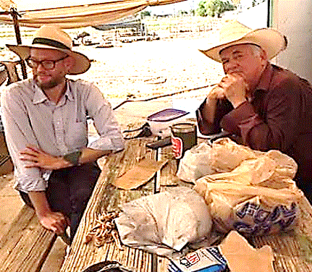
Producers
School Food Authorities (SFAs) can receive donations from local farmers, ranchers, fishers
SFAs can purchase food directly from local farmers, ranchers, fishers
SFAs must adhere to federal, state, and local procurement rules and regulations at all times
SFAs will follow many of the same best practices as purchasing product from school farm/garden
Find farmers
Talk to farmers (commonly menu’ed and grown foods, volumes, sizes, food safety consistent quality, price points, packaging, distribution)
Plan
Procure
Notes:
Sponsors can choose to purchase foods directly from local farmers, ranchers and fishers.
Sponsors can accept donations from local farms the same as with garden donations.
Sponsors can also purchase produce following the procurement regulations. In many cases, this may be using the micro-purchase or informal purchase method. For micro-purchase or purchases under $10K, sponsors would need to make sure that purchases are reasonable and equitably distributed among qualified suppliers and document all purchases. They can go straight to local growers in there community. Document all purchases. For small purchases under $250K, sponsors can also target local producers with their solicitations. (Gold standard 3 or more.) Sponsors can also write product specs or technical requirements to target local.
To find producers, many states and communities make available local seasonality charts and lists of local producers. Sponsors can contact State F2S coordinator, DOA, county extension, farm bureau, non-profits, farm to school associations, producer associations, or farmers markets.
Sponsors can also set up forward contacts with producers in advance of the growing season. Forward contracting follows the same requirements as any other small or formal purchase.
If sponsors plan to source direct from farms (or gardens), they should be encouraged to start talking with producers as soon as possible. It’s important that producers and food service communicate important details that allow the process to be successful for both: product, quantity, processing, packaging, menu and serving plans, distribution, price point.
If the product or partner is new to the sponsor, piloting or testing product is important strategy that may help both parties to be satisfied with the final result.

Slide 27
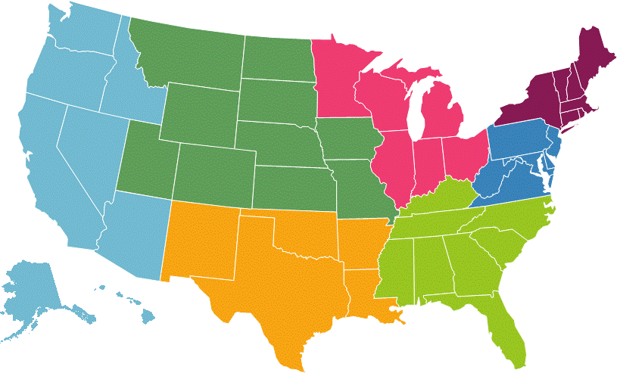
Garden/Farm to Cafeteria Protocols
Garden/Farm to Cafeteria Resources
Whole Kids Foundation/Slow Foods USA’s Garden to Cafeteria Toolkit
Life Lab’s Policies and Protocols for School Gardens and Garden to Cafeteria
Austin Independent School District’s Garden to Café Conditional Approval of a School Garden Food Source
Sourcing from Local Farms
Minneapolis Public Schools’ Farm to School Toolkit
Washington State Department of Agriculture's Distribution Models for Farm to School
Notes:
Whole Kids Foundation/Slow Foods USA’s Garden to Cafeteria Toolkit
The toolkit builds off the successes and safety protocols of five school districts across the United States to provide templates and a step-by-step process to help District Food Services develop their own protocols. It is developed based on the successes of the following school districts:
• Austin Independent School District • Chicago Public Schools • Denver Public Schools • San Diego Unified School District
MPS
This toolkit is designed to describe MPS’ farm to school program and share the many useful tools, resources and documents that have been developed since its inception. Readers will get an overview of how MPS purchases and serves fresh produce from small and mid-sized, sustainable farmers in the region. The primary audience for this toolkit is food service directors and staff at schools or other institutions who wish to serve locally grown foods, as well as partners who serve to support or fund farm to school programs.
WSDA
With farm to school programs, the transport of farm products to the schools is in many cases the most challenging issue to be addressed. There is no “one size fits all”, as individual circumstances differ greatly. Some of the issues to consider are:
School district size and the existence of central kitchens or satellite kitchens
Storage capacity of the schools
Existence of farmer cooperatives or networks
Capacity of these networks to deliver
Distance involved with deliveries
Volume and type of products desired
Amount of staff time needed to research and develop the distribution method.

Slide 28
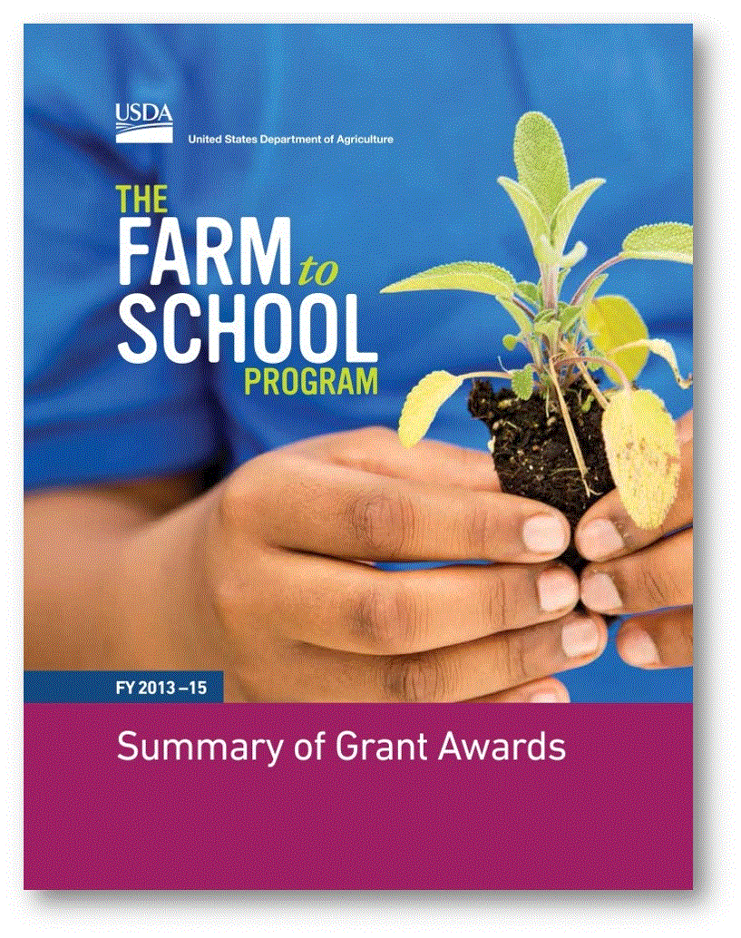
USDA Farm to School Grants support:
Training
Supporting operations
Planning
Purchasing equipment
Implementing farm to school programs
Developing school gardens and curriculum!
Notes:
- Eligible Farm to School Grant applicants: State Agencies, local government, ITOs, schools, nonprofits, producers
- Distributed over $25 million since 2013

Slide 29
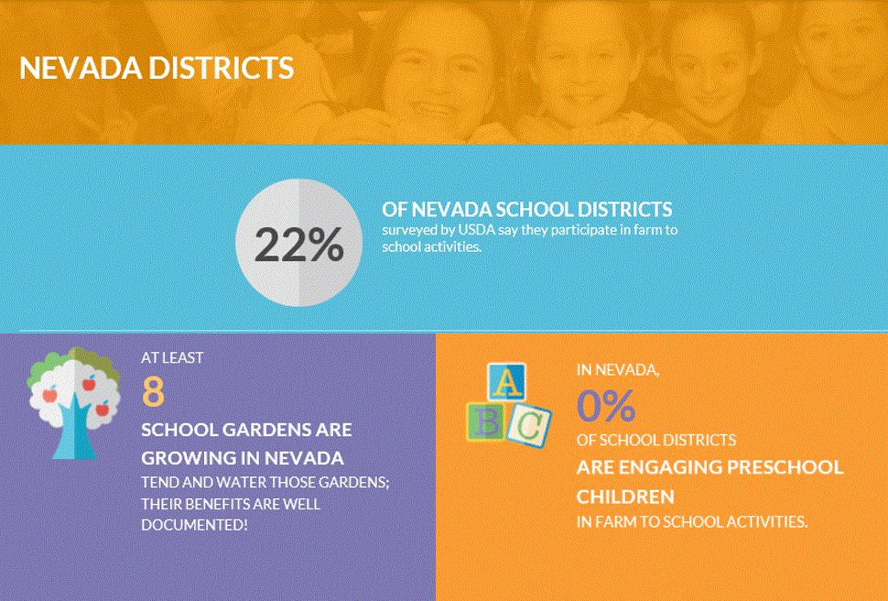
USDA Farm to School Census
The Census is coming…Fall 2019!
How can you help?
Partner with your School Food Authority
Provide district/preschool accurate data on:
# of edible school gardens
Use of edible school gardens
Garden/farm visits
Food education activities
https://farmtoschoolcensus.fns.usda.gov/
Notes:
FNS has contracted with the research firm, Abt Associates, to administer the 2019 Farm to School Census. State Child Nutrition offices will provide Abt Associates with SFA names, the names of SFA Directors, and their contact information.
SFAs will start receiving communications about the Census in 2019.
Communications about the Census will come from Abt Associates, as well as your State agency.
The Census will be sent to the SFA’s Director during the winter of 2019. Directors are strongly encouraged to collaborate with other entities within the district, such as vendors, school garden coordinators, foodservice staff, or teachers, to obtain the most accurate data. The data collection period will last a few months; however, it is best to prepare for the Census now.

Slide 30
OCFS Online Resources
Grant Details
Planning Toolkit
Planning Guide
Planning Webinar Series
Fact Sheets, Policy Memos, and more!
https://www.fns.usda.gov/farmtoschool/farm-school-resources
Notes:
We just revised our Procuring Local Foods for Child Nutrition Programs guide- part of that revision includes how to procure from school gardens

Slide 31
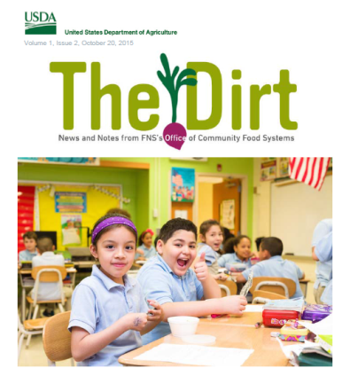
Delivered every other Tuesday, chock full of updates, webinar info, relevant news, and field notes! More than 20,000 subscribers.
Subscribe at www.usda.gov/farmtoschool

Slide 32
PEAS, I MUSTACHE YOU A QUESTION…
Notes:
Now I will open it up to you all – does anyone have questions?

Slide 33
THANK YOU!
JuliAnna Arnett, WRO Farm to School Lead
Email: Julianna.Arnett@fns.usda.gov
Phone: 415-293-3720
Web site: https://www.fns.usda.gov/farmtoschool/farm-school

