Slide 1
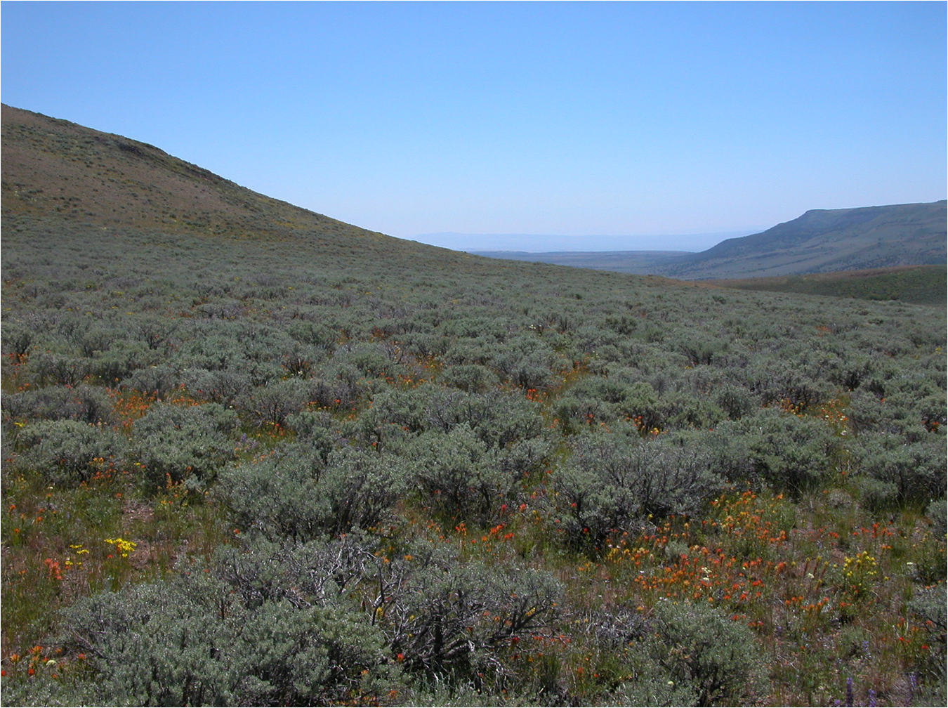
The Economics of Native Seed: Market Risk, Production Risk, and the Supply of Native Plant Materials in Nevada
Michael H. Taylor
Dept. of Economics &
Cooperative Extension
University of Nevada, Reno
Nevada Native Seed Forum
Bristlecone Convention Center, Ely NV
22 May 2018
Photo Courtesy of Jon Bates
Notes:
Abstract: We discuss the challenges to ensuring the availability of genetically appropriate native seeds for wildland restoration in Nevada and throughout the intermountain west. We present a framework for identifying the characteristics of seed species that suggest that additional policy is required to ensure its stable supply to the market. Our approach distinguished between production and market risk. Production risk relates to variability in production yields; market risk relates to the year-to-year variability in the price.
Two separate goals
Increase the supply of genetically-appropriate native seed and plant material for restoration and post-fire emergency rehabilitation projects in Nevada
But: The seed could be cultivated in outside the state.
To increase supply of seed and plant material produced in Nevada, with a focus on cultivation over wildland collection. Income diversification for agricultural producers in Nevada. Help achieve rural development goals.
But: The seed and plant materials could be grown in Nevada and used in (i) non-wildland restoration applications (e.g., ski resorts, golf courses, etc.) and (ii) could be sold out of state
Fundamental Question
How are these two goals related?
Why is it important to have a network of native seed producers in Nevada to better meet ecological restoration goals?
The answers to this question are in this room

Slide 2

Introduction
Why Native Seeds and Plant Materials?
  Increased the likelihood that restoration and post-fire rehabilitation projects will be successful at restoring desired ecological function
National Policies
  2015 National Seed Strategy for Rehabilitation and Restoration
  2015 Department of Interior Secretarial Order No. 3336 (Rangeland Fire Prevention, Management and Restoration)
  2014 Presidential Memo Creating a Federal Strategy to Promote the Health of Honey Bees and Other Pollinators

Slide 3
Introduction
Native Seed Industry in Great Basin
  Demand driven by post-wildfire rehabilitation
  Production challenges for many species (low-stature, indeterminate flowering, uneven seed maturation) or unknown agronomic performance
  High fixed costs (infrastructure, equipment, working capital) to run native seed operation
Sagebrush Ecosystem Restoration Research Team (SERRT)
  Increasing the supply and lowering the cost of native plant materials for restoration and post-fire rehabilitation in Nevada
  Encouraging the growth of the native plant material industry in Nevada
Notes:
Two separate but interrelated goals
Increase the supply of genetically-appropriate native seed and plant material for restoration and post-fire emergency rehabilitation projects in Nevada
But: The seed could be cultivated in outside the state.
To increase supply of seed and plant material produced in Nevada, with a focus on cultivation over wildland collection. Income diversification for agricultural producers in Nevada. Help achieve rural development goals.
But: The seed and plant materials could be grown in Nevada and used in (i) non-wildland restoration applications (e.g., ski resorts, golf courses, etc.) and (ii) could be sold out of state
Fundamental Question
How are these two goals related?
Why is it important to have a network of native seed producers in Nevada to better meet ecological restoration goals?
The answers to this question are in this room

Slide 4
Introduction
Why Restoration Treatments Fail
  Wrong seed (sagebrush, perennials; not early seral stage plants that compete with annual grasses)
  Wrong timing (paperwork, etc. delays planting)
  Strategic mistakes (seed choice doesn’t consider “fine resolution” such as aspect, elevation, soils, moisture, etc.)
  Inappropriate seeding/plating rates
Notes:
Successful Planting
Selecting suitable species that meets conservation needs/resource concerns
Seeding rate: how much to purchase; pure live seed; lbs per acre
Goal of seeding in terms of plant density
Too low: invasive weeds
Too high: Competition for water and resources
Plant density to provide cover for wildlife
Planting Rates: For Mixture of Species
Planting rate for each species takes into account other species in the mix

Slide 5
Demand for Native Seed and Plant Materials in Nevada
Federal
  Bureau of Land Management (BLM)
  U.S. Forest Service (USFS)
  U.S. Fish and Wildlife Service (USFWS)
State
  Nevada Division of Wildlife (NDOW)
  Nevada Department of Transportation (NDOT)
Other
  Private with Natural Resources Conservation Service (NRCS) assistance
  Private no assistant (potentially harvest their own)
  Mining Reclamation/Mitigation
  Nature Conservancy other NGOs
Notes:
To varying extents, all federal agencies now operate under directives to move more towards natives

Slide 6
Demand for Native Seed and Plant Materials in Nevada
BLM Seed Buying Policy
  BLM Secretarial Order 336
  BLM used to buy seed on a 10 year average formula; stopped making sense in early 2000s because of rapid increase in burned acres
  BLM makes consistent national buys every year through its Boise office to match with predicted wildfire activity; Also makes “conditional buys” to deal with large wildfire years
  Seed warehouses in Ely, Boise, & Twin Falls; refrigerated (necessary for sage brush and several other species)
Monopsony?
  Conflict between the BLM’s role of the largest purchaser of native seed in Nevada and throughout the Intermountain West with the goal of minimizing seed procurement costs and its role in trying to encourage the level of native seed production.

Slide 7
Federal/State Partners
Nevada Dept. of Agriculture (NDA)
  NDA supports producers in the native seed industry (and seed industry in general) by providing low-cost (i.e., subsidized) source identification, weed-free, etc. certification
Natural Resources Conservation Service (NRCS)
  1. Developing native plant material (Plant Materials Centers); 2. Cost-sharing native seed purchases (NRCS approved seed mixes); and 3. Technical assistance to native seed growers (District conservationist)
Fish and Wildlife Service (FWS)
  1. Reviews seed mixes; 2. Regulatory role if EIS in effect; 3. Otherwise has a advisory/public service role
Nevada Division of Wildlife (NDOW)
  Pays for additional seed in ES&R seed mixes used by BLM/USFS; New hire to work in BLM seed warehouse; collects data; funds restoration
Nevada Division of Forestry (NDF)
  Collects and purchases seed for NDOW and others.
Notes:
Seven Players in Nevada
Federal: BLM, USFS, NRCS, FWS
State: NDOW, NDF, NDA
Great Basin Native Plant Project
Help managers make decisions about genetically appropriate materials and technologies for vegetation restoration
Potential species response to climate change
Seed transfer research
Develop seeding technology and equipment

Slide 8
Supply of Native Seed and Plant Materials in Nevada
USDA Census of Agriculture
  2007
    19 producers – All seed producers only produced Alfalfa seed
    6,498 acres (all irrigated)
    4,237,101 lbs produced
  2013
    16 producers; 15 Alfalfa seed only
    Acres no reported for Alfalfa; 4,361 acres total (all irrigated)
    3,409,526 lbs produced
Notes:
Watershed Restoration Initiative in Utah
Work with specialized seed producers
Partnerships with “hobby” producers less successful

Slide 9
Challenges to Supplying of Native Seeds and Plant Materials
Market Risk: Variable Demand
  Year-to-year variability in the price
  Demand driven by post-wildfire rehabilitation; One-off rehabilitation projects
Production Risk: Variable Yields
  More variable yields than for conventional commodity crops
  Production challenges for many species
Notes:
Native Seeds and Plant Materials
Increase the likelihood that restoration and post-fire rehabilitation projects will be successful at restoring desired ecological function
Availability and cost of natives are a significant obstacles their widespread use in restoration (Mock et al. 2016)
Wildland Collection
Commercially cultivated species implies that it has a lower average cost of production than wildland collection. Despite lower average costs, however, the market risk associated with a particular species may make wildland collection the more attractive method for procuring these seeds.

Slide 10
Challenges to Supplying of Native Seeds and Plant Materials
Production Challenges for Native Seeds
  One or two years of establishment before production can begin
  Small, diverse stands; Different harvest schedules
  High cost of sowing, cleaning, harvesting, and marketing
  Transaction costs for wildland application: Certification fees, quality verification testing, finding buyers
  Labor costs associated with maintaining a certifiable product (e.g., hand weeding and monitoring)
  Native species have lower germination rates and more varied growth characteristics

Slide 12
Market Risk
Low Risk
  Consistent inter-annual demand
  Example: Native and non-native cultivars
Medium Risk
  Variable inter-annual demand
  Examples: Demand driven by wildfire and ES&R
High Risk
  High variability; one-off projects
  Examples: Forbes from narrow seed zone

Slide 14
Production Risk
Low Risk
  Commercially cultivate with low variability in yields
Medium Risk
  Medium/high variability in yields
  Predictable risk
High Risk
  Average yield and variability unknown or volatile
  Cultivation may not yet have been shown to be commercially viable
Notes:
Often if there is an seed/plant material on the market, it is through wildland collection

Slide 20
Research
Research

Slide 22
Policy Recommendations
Systematic Data Collection
Seed Needs Data Base
Watershed Restoration Institute Model (watershed.utah.gov)
  Review and rank projects/leverage funds
  Consolidated seed buys
Market Risk
  Continue and enhance warehouse system
  Expanded use of forward contracts (IDIQs)
  Standing orders
Production Risk
  Provide growers with native seed stock
  Agronomic research and technical assistance
Industry Consolidation
  Good for suppliers of native seeds; Bad for end users
Notes:
Sage grouse
Post-fire, with emphasis on soil stabilization, with far less emphasis on native seeds

Slide 23
Thank You!
Acknowledgement:
  U.S. Fish and Wildlife Service
  Sagebrush Ecosystem Restoration Research Team (SERRT) Project

Slide 24
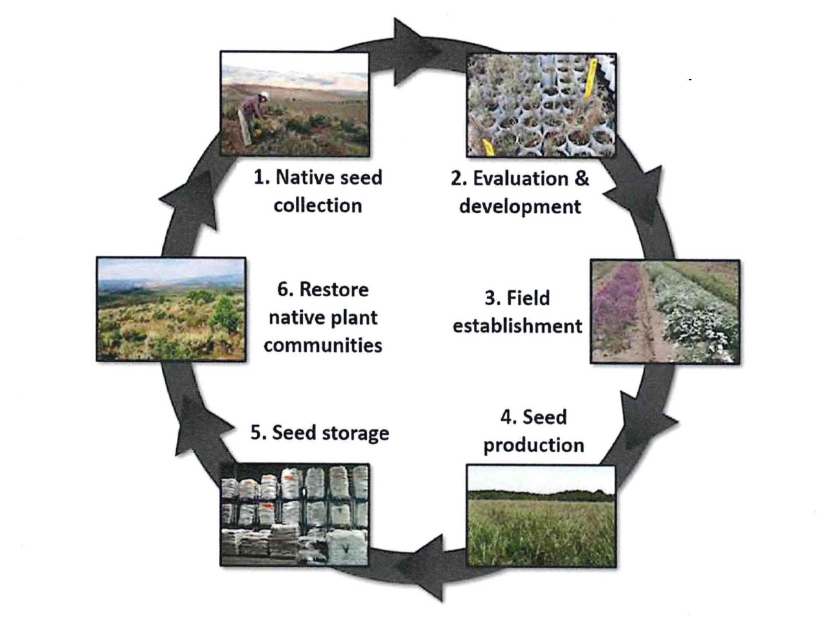

Slide 25
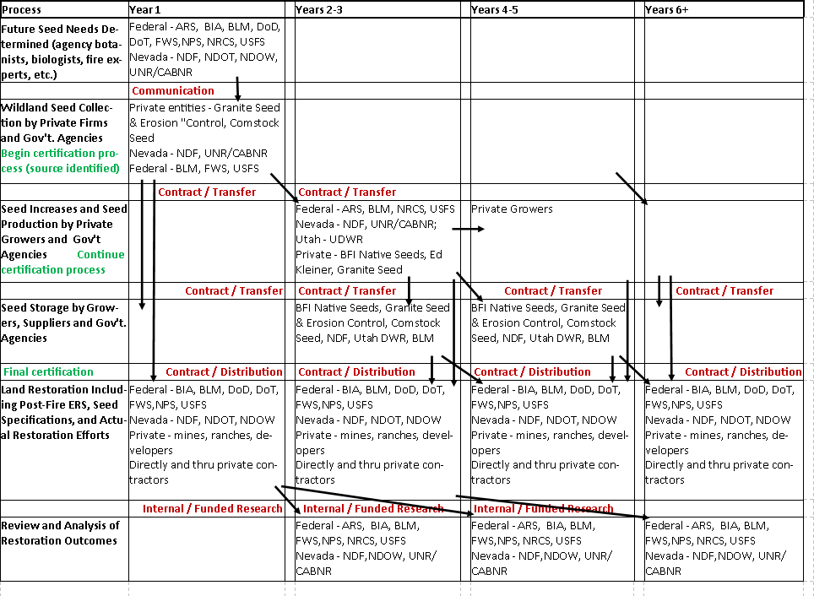
Policy Recommendations
Notes:
Native Seed Industry: Development, Production and Utilization Processes

