Slide 1
National Seed Strategy and
Its Impact in Nevada
Fred Edwards
Great Basin
Ecoregional Coordinator
Bureau of Land Management
Reno, Nevada
Sarah Kulpa
Botanist/Restoration Ecologist
US Fish and Wildlife Service
Reno, Nevada
Dirk Netz
Forest Botanist
US Forest Service
Sparks, Nevada
May 22, 2018 – Native Seed Forum, Ely, NV
Notes:
May 22, 2018
Native Seed Forum - Ely, NV

Slide 2
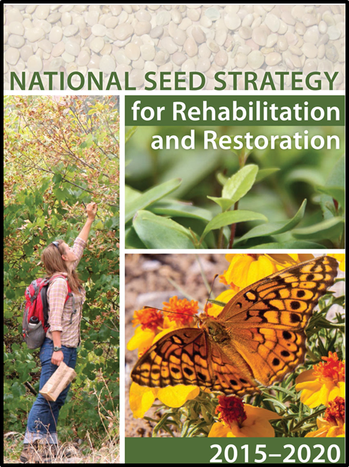
A Coordinated Approach: “The Right Seed in the Right Place at the Right Time”
Signed in Aug 2015
Calls for an Unprecedented Level of Collaboration
Seed Needs & Ensuring Reliable Availability
Research Needs like Ecologically Based Seed Transfer Guidance and Improved Technology
Develop Tools to Inform Seeding Decisions
Internal and External Communication
Notes:
Network of networks to implement the National Seed Strategy.

Slide 3
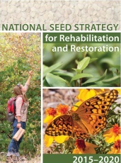
Networks of Networks in Nevada
Networks of :
Seed Collectors
Researchers
Farmers
Nurseries and seed storage facilities
Restoration ecologists and botanists
Networks of:
Public Land Managers
Policy Makers
Tribal Land Managers
Private Land Owners
Communication and Education
Bridging the Gap
Between
Notes:
And this is what we are trying to establish here

Slide 4
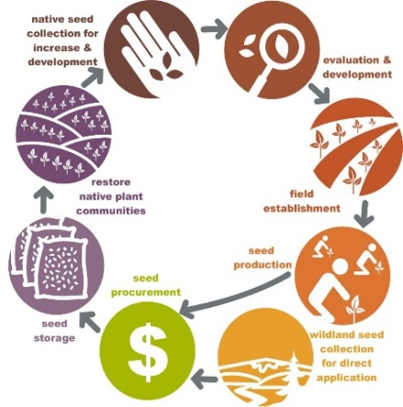
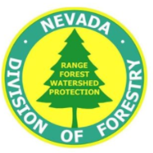
Native Plant Development Partnerships
Collecting Seed:
Federal Agencies
GBNPP
State Agencies
Non-Profit Groups
Studying How to Germinate, Establish, and Manage Fields:
GBNPP
Universities
NRCS Plant Materials Centers
Private Growers
Develop Seed Transfer Guidance:
GBNPP
Using Seed:
Federal Agencies
State Agencies
Universities
Mining Industry
Ranchers
Developers
Transportation
Outreach to Growers:
NRCS Plant Materials Centers
Resource Conservation Districts
State Dept. Ag
Understanding How to Use Seed:
GBNPP
Universities
USGS
Helping Growers Establish Fields:
Resource Conservation Districts
NRCS Plant Materials Centers
Producing Seed:
Non-Profit Groups
Private Growers
State Nurseries
Storing Seed:
Federal Warehouses
Private Growers
State Seed Warehouses
Procuring Seed:
Federal Agencies
Seed Industry
Seed Certification Programs
State Agencies
Seed Cleaning and Testing Facilities
Crop Improvement Associations
Collecting Wildland Seed:
Federal Agencies
State Agencies
Non-Profit Groups
Seed Industry
Mining Industry
Seed Cleaning and Testing Facilities

Slide 5
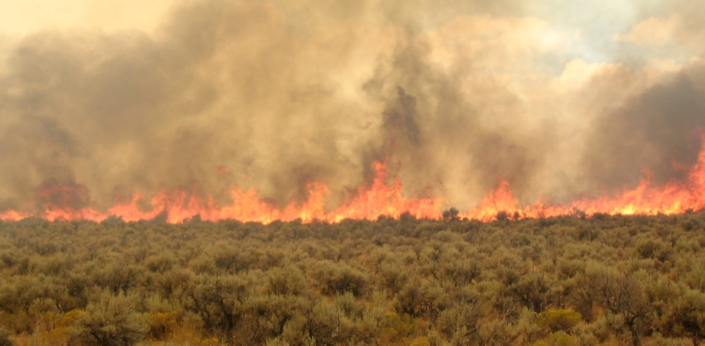
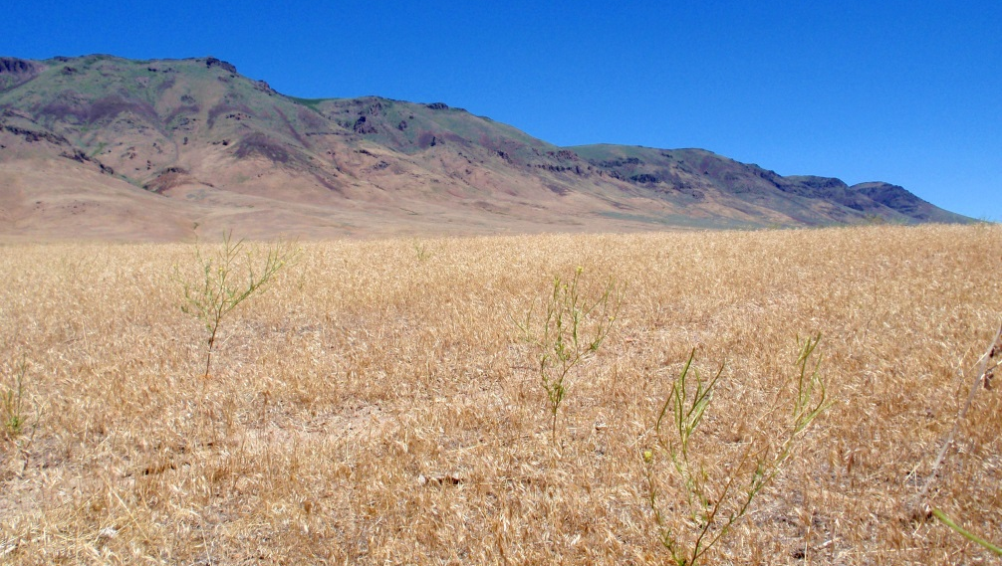
Why do we need seed? Ecological realities of the Great Basin
Increasing Fire Frequency
Increasing Cheatgrass Densities
Loss of Native Seed Sources
Loss of Resistance and Resilience
Notes:
Native seed is critical to future management of the Great Basin. Past land management practices and invasive, non native annual grasses have fundamentally changed sage steppe ecosystems.

Slide 6
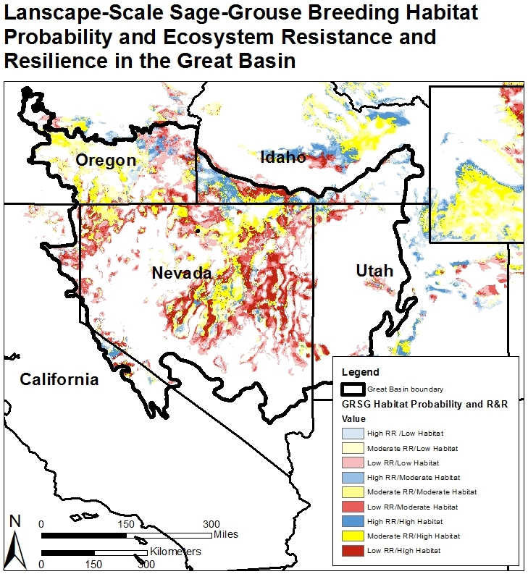
Loss of resistance and resilience in the Great Basin
Chambers et al. 2017
Notes:
Land Managers can no longer rely solely on natural recovery. More often than not some seeding will be needed. This is a map from the Science Framework for Conservation and Restoration of the Sagebrush Biome, Part 1.
This map shows sage-grouse breeding habitat probabilities based on 2010-2014 lek data intersected with resilience and resistance categories developed from soil temperature and moisture regimes.
If you look at Nevada and the adjacent states- you will see red and yellow. Red means low R&R and yellow moderate R&R. Once plant communities are driven to a red state of low R&R (likely due to multiple stressors impacting a community), they have a less likely chance to recover without human intervention. Blue areas tend to be areas that are likely to recover naturally because they are cooler and wetter, and tend to be higher elevation sites that have not yet been invaded by cheatgrass.

Slide 7
Why Care about Native Seed?
Foundation of resilient and resistant ecosystems
Supports healthy populations of wildlife species
Creates biodiversity and ecosystem services
Key to cost effective and successful restoration
Notes:
If we want to add back resistance and resilience to the GB, we need to use native species, there is no way around it. Native grasses and forbs are the foundation of health pollinator and sage grouse populations and species diversity is the key to creating species diversity and ecosystem services.

Slide 8
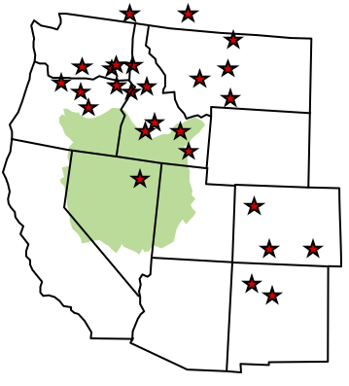
What Seed is Used Now for Restoration in the Great Basin?
Mostly grasses
Mostly cultivars
Mostly from the northern, wetter edges of the Great Basin
Selected for agronomic or forage qualities
Shrubs and a few forbs are mostly wildland collected
Leger and Baughman 2015
Notes:
What native seed do we use now in the GB? Its mostly grasses and cultivars that originate outside of the Great Basin. These cultivars have been selected for agronomic production (seed production, biomass for forage) not for how well they can establish and survive in a wildland setting….

Slide 9
Problems with Current Approaches to Native Seed Sourcing
“Cultivated Variety”
“Locally Collected”
Many cultivars and named releases are a poor “fit” between seed source and restoration site = less effective
Does not restore or mimic natural population functioning
Potentially disrupt ecological relationships
Potentially undermines future resistance and resilience
Too much time to get seed
1-2 years for local seed collection and 2-3 years for seed production
Local seed sources may no longer exist
Climate shifts may mean local seed sources are not the best
May not immediately germinate and grow
Notes:
There are currently two approaches to procuring native seed: the agronomic and the local approaches. Neither the Agronomic or “Local is Best” Approach will be effective on its own- we need to blend the two. Here some of the challenges with each that we need to over come.

Slide 10
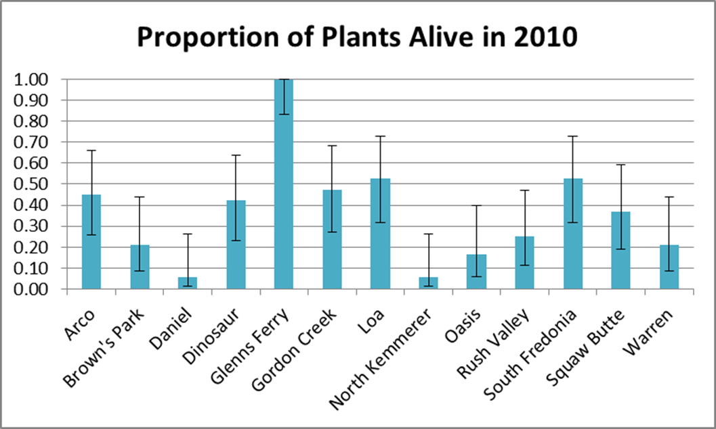
What Can Happen When Seed Sources Do Not Match?
ID
UT
WY
CO
ID
UT
UT
WY
UT
UT
AZ
OR
MT
Science Magazine- 2015 http://www.sciencemag.org/news/2015/01/plan-save-monarch-butterflies-backfires
Wyoming Big Sagebrush Survival from 13 Locations Planted in Glenns Ferry, ID in 1987 Sands and Moser 2013
Notes:
Here are a couple examples of the consequences of local adaptation.
The first is long term survival of Great Basin sagebrush plantings 23 years after planting …. Only plants with close to 100% survivorship are the plants grown from seed at the source.
The second, is a 2015 publication in Science Magazine that shows that well-meaning gardeners might actually be endangering the butterflies’ iconic migration to Mexico. That’s because people have been planting the wrong species of milkweed, thereby increasing the odds of monarchs becoming infected with a crippling parasite.”

Slide 11
Local adaption matters
Local Adaption is more common than not in the Great Basin
Variation is usually correlated to environment of origin
More often than not, local population outperform nonlocal
Basic climate factors can explain variation across taxa
Effects Restoration Success
Local adaption in the Great Basin - Baughman et al. 2018, in revision
Notes:
Owen Baughman and collaborators reviewed papers that covered over 3200 populations from 327 experiments in 170 studies. 104 species – and over 350 common garden research studies in the Great Basin.
Their paper is coming out soon. T
he results are more complicated than I’m going to go into here…. But know more often than not, local adaptation is happening. Its happening in real time, there is evidence of natives adapting to invasive species,
We need to pay attention to it if we want our seeding projects to be successful.
Details: 1) among-population differences in phenotypic traits, 2) trait-by-environment associations, and 3) higher fitness of local populations. From 327 experiments testing 121 taxa in 170 studies, we found 95.1% of 305 experiments reported signature 1, and 81.4% of 161 experiments reported signature 2. Locals showed greater survival in 67% of 24 reciprocal experiments that reported survival, and higher fitness in 90% of 10 reciprocal experiments that reported reproductive output.

Slide 12
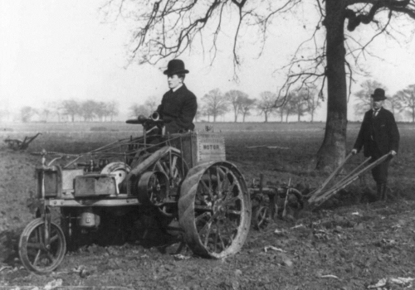
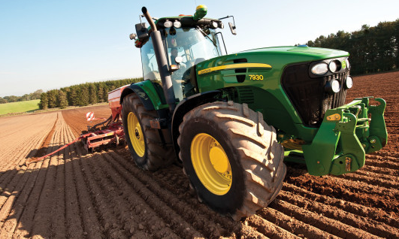
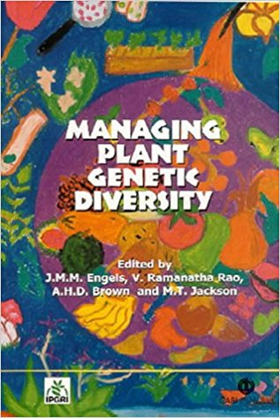
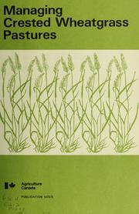
What will seeding look like in the future?
Late 19th Century
Early 21st Century
What does native seed technology look like in the 21st Century?
Notes:
Technology has radically changed from 1898 when crested wheat was first imported to the United States. - If you think about it…. cars, phones, and planes have radically evolved…however, the way we manage public rangelands in the Great Basin has not fundamentally changed. Its time for the native seed sources we need to also evolve.
We are seeing the future now. The way the BLM is buying and using seed is changing. The Seed warehouse is procuring and using seed based on seed transfer guidance up to 30% of the seed purchased is by seed transfer zones.

Slide 13
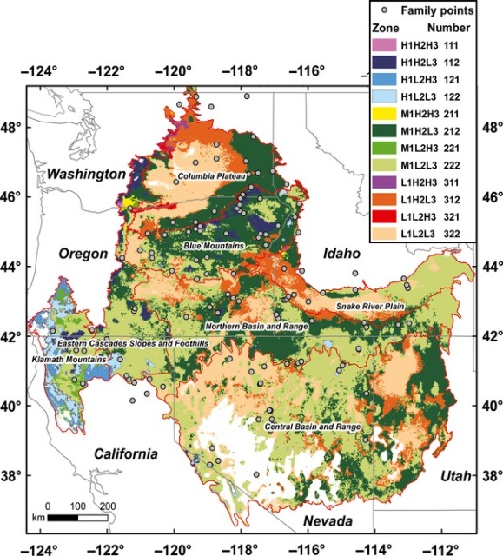
Seed Zones: A compromise for addressing local adaptation
A mapped area with a fixed boundary which seeds or plant materials can be transferred for the best chance of success
Developed in the 1920s
Models based temperature and aridity (provisional)
Models based on climate variables and genetic adaptation (empirical)
Bower et al. 2014
Johnson et al. 2015
Notes:
So what is Seed Transfer Guidance? Seed transfer maps are a picture of what that evolution looks like on the landscape…. Simplistically put, They are models based on temperature and precipitation (it is a little more complex than that- but pretty close)- This is called provisional seed transfer guidance,.
When genetic information (usually in the form or a common garden experiment- this is just growing plants from different seed sources in the same place and comparing how similar or different the seed sources are…) is added then the guidance is called empiric.
Shown here is a picture of the first provisional seed transfer zone map of the US produced by Bower et al. – You should notice two things- east of the Rocky Mtns you see nice bands the relationships between temp and precipitation are pretty simple. If you look east where BLM managed lands are, you will see that elevation and topography complicate the picture.

Slide 14
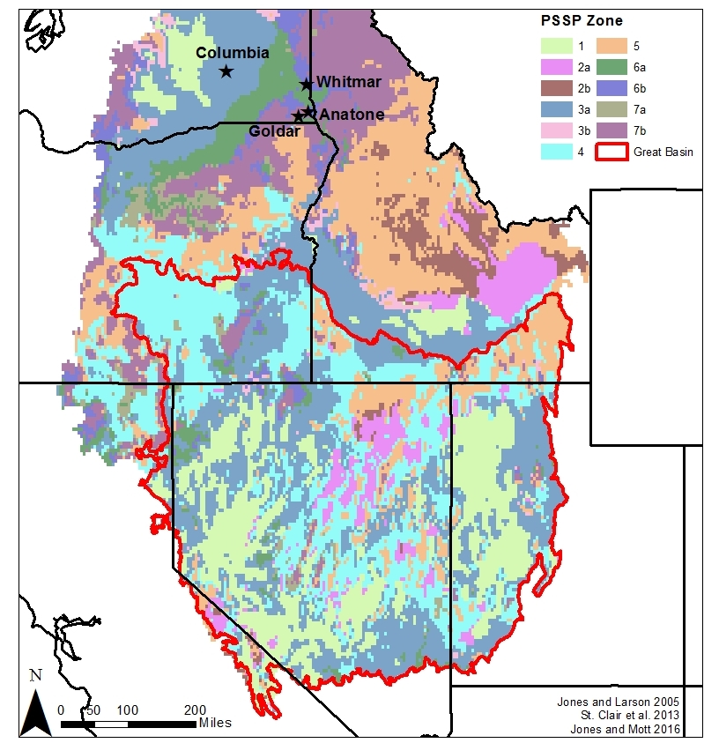
What seed zones do cultivated varieties of bluebunch wheatgrass used in the Great Basin come from?
Notes:
So what seed zones does blue bunch wheatgrass come from? Does it match with the warmer and dryer sites in the northern and central Great Basin?
Empirical Seed Zones of Bluebunch

Slide 15
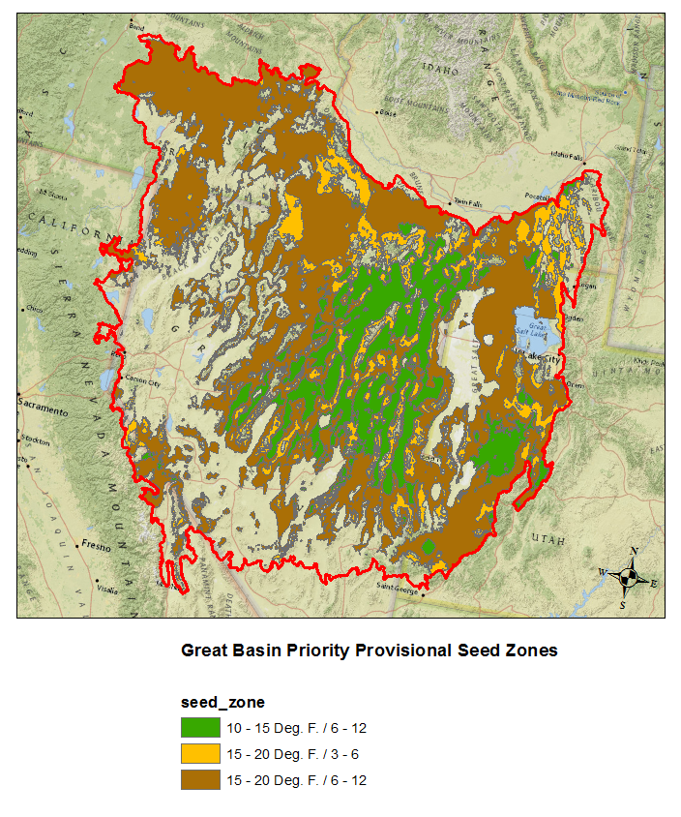
Great Basin Provisional Seed Zone Analysis
From 20 Provisional
zones to 3
Covers approximately
75% of the GB
Using Sage-grouse Priority Habitat and fire history
Using Bower et al 2014
Notes:
On an interagency Basis, BLM, FWS and FS have identified which seed zones have the widest utility

Slide 16
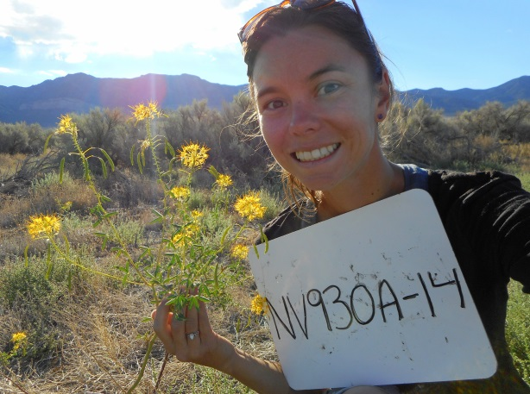
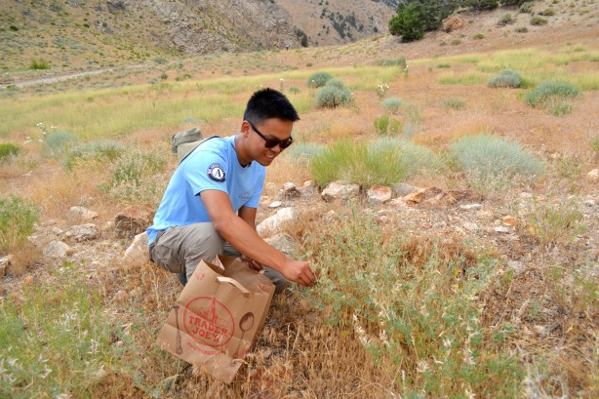
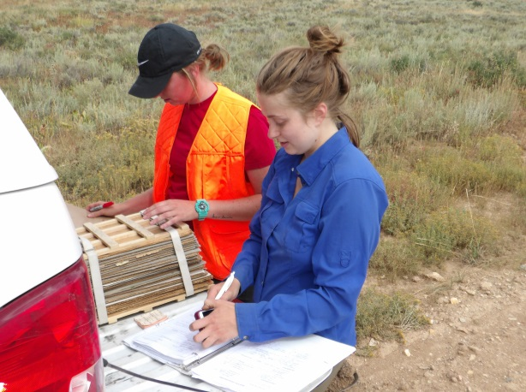
2018 Target Species for Seed Collection
 | Common name | Scientific name
Grasses | Indian ricegrass | Achnatherum hymenoides
 | Thurber's needlegrass | Achnatherum thurberianum
 | Squirreltail | Elymus elymoides
 | Great Basin wildrye | Leymus cinereus
 | Sandberg's bluegrass | Poa secunda
 | Bluebunch wheatgrass | Pseudoroegneria spicata
Forbs | Douglas dustymaidens | Chaenactis douglasii
 | Hoary tansyaster | Machaeranthera canescens
 | Yellow beeplant | Cleome lutea
 | Tapertip Hawksbeard | Crepis acuminata
 | Globemallow | Sphaeralcea sp.- ambigua, coccinea, grossulariifolia, munroana,
Notes:
On an interagency basis we have identified 6 grasses and forbs that have widespread utility and can be commercially produced. These are primary workhorse species we want to bring into the commercial market and facilitate development of empiric seed transfer guidance.
The six grasses all have empiric seed transfer guidance- so we are targeting seed collections that can be source identified and increased.
The six forbs do not have empiric seed transfer guidance, we are working with Rocky Mountain Research Station to set up common gardens that will help us develop this guidance. We are targeting seed collections to help us with this research as well as initiate commercial seed increase contracts.

Slide 17
Interagency Strategies to Support Industry
Increase Seed Source Availability | Minimize Grower Risk | Increase Market Stability
Work with partners to provide foundation seed originating from public lands | Add native seed crops to the National Crop Table so they are eligible for federal crop insurance | Focus on priority species and priority seed zones
 |  | Use forward contracts (IDIQ) to guarantee production for 3 to 5 years
Work with partners to source identify seed used for seed increase and purchase source idenfied seed back | Consolidate and release research and development on production for native species in a Seed Manual | Standardize seed procurement across jurisdictions
 |  | Forecast anticipated seed needs by seed zone and species

Slide 18
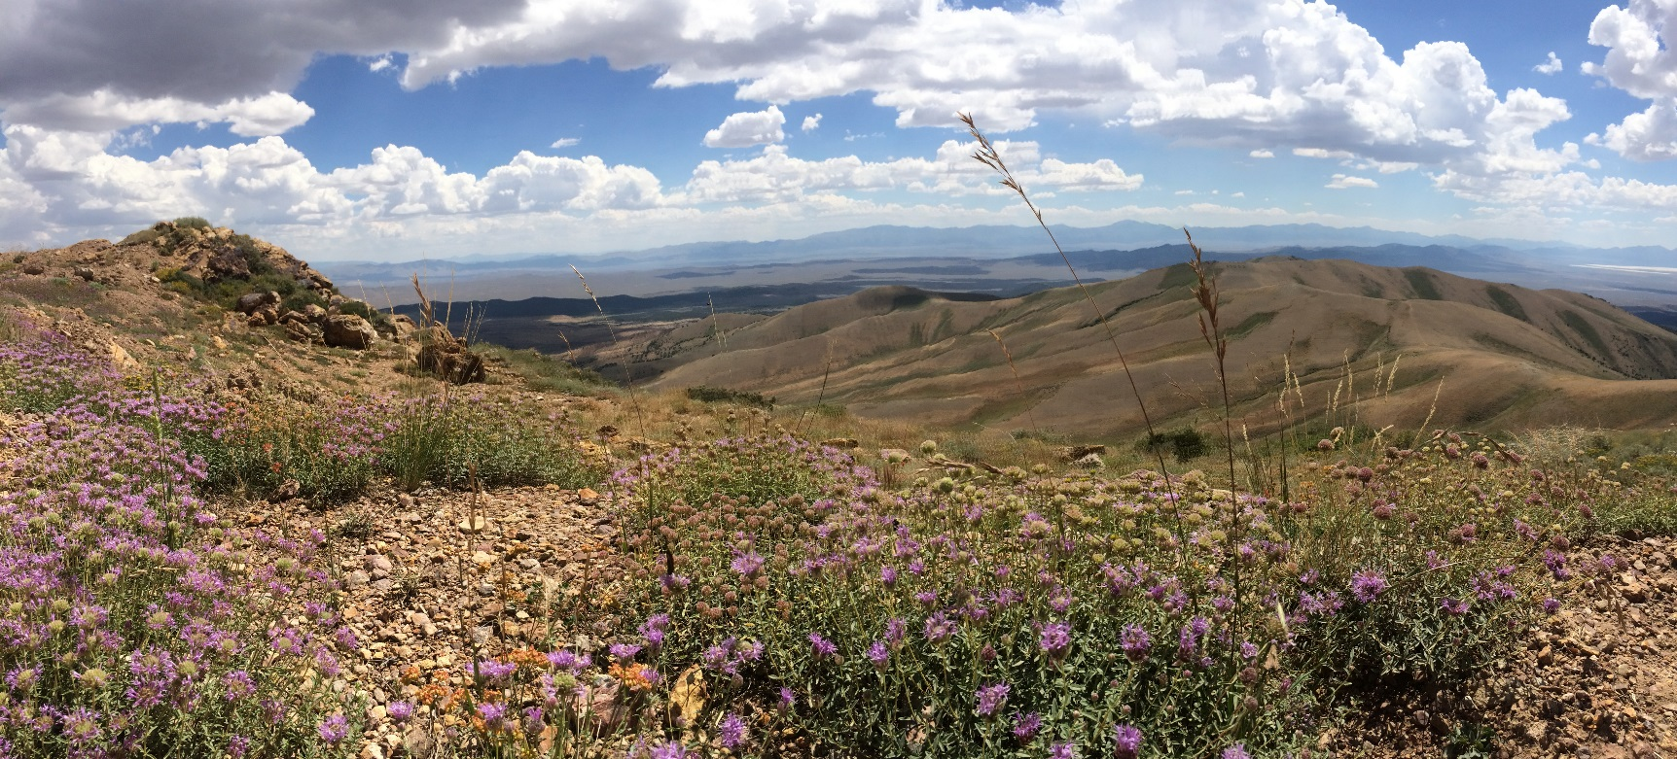
Thank You
Fred Edwards fsedwards@blm.gov; Sarah Kulpa sarah_kulpa@fws.gov;
Dirk Netz dnetz@fs.fed.us ; Francis Kilkenny ffkilkenny@fs.fed.us

