Slide 2

CACFP Updates

Slide 3
Training
CACFP Updates
The Nevada Department of Agriculture now has the following trainings available:
Intro
Online training for potential new sponsors. Completion is required before submitting an initial application. This training can also be used to cover the basics for new operational and administrative staff.
CACFP101
Consists of two different tracks. The Administrative Responsibilities training focuses on recordkeeping and would be suitable for new designated officials and administrative staff. The Meal Service training pertains to the meal pattern(s) and meal service requirements, this training would be suitable for day care home providers, new cooks, and operational staff.
Meal Pattern
A comprehensive look at the meal pattern. This training is intended for new staff, day care home providers, or existing sponsors that upon review were not complying with the meal pattern.

Slide 4
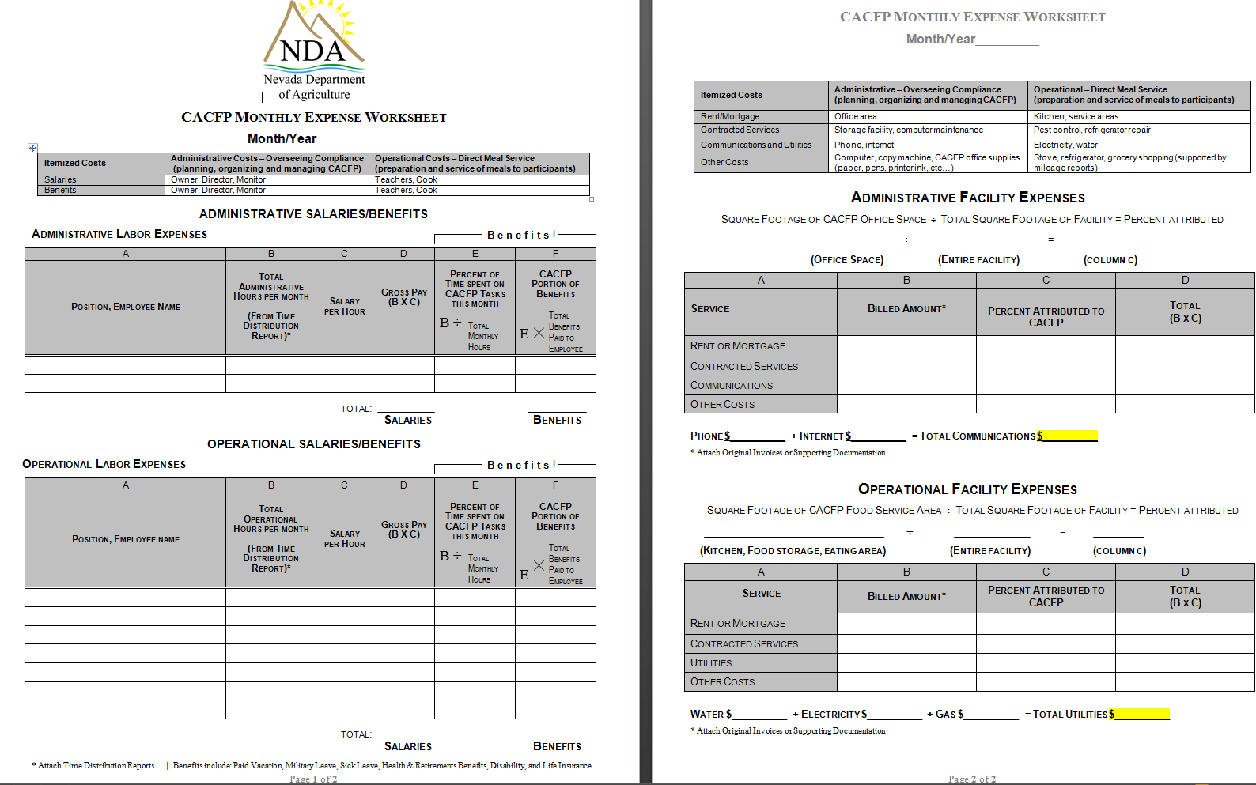
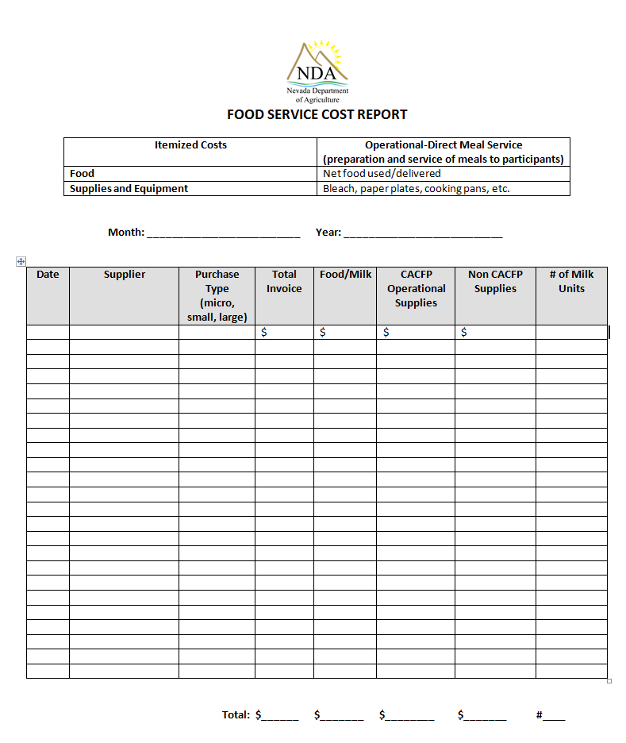
Forms
CACFP Updates
Under the Sponsor Resources Financial Management Tab on CNP web we now have the following forms:
The monthly expense worksheet will help you keep track of administrative and operation expenses
The food service cost report will allow you to track your monthly food cost, gallons of milk purchased, and what type of purchases you are making

Slide 5
Common Review Findings

Slide 6

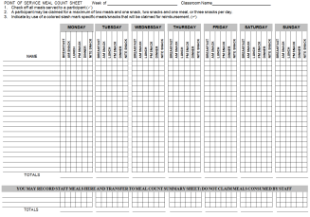



Common Review Findings
Excluding Infants
Your organization must offer reimbursable meals and snacks to all infants onsite.
Point of Service
Meal counts must be taken as children receive reimbursable meals and cannot be based on attendance sheets. Meal count sheets must be signed by person taking point of service and dated.
Milk Substitutions
If a participant requires a milk substitute, it has to be one listed on the approved list. The list is on CNP web under Sponsor Resources-Meal Patterns. A parent can sign and provide an approved milk substitute.
Meal Pattern
Meal Production
Make sure all of your menus are compliant. The entire required serving of milk must be poured into the cups at the beginning of meal service for young children who need help in family style meal service and pre-plated meals. **Remember that 2% milk is not creditable**
Number of meals prepared or delivered need to be adjusted to trends in participation with the goal of one meal per participant and food service staff who prepare meals or eat with participants.

Slide 7
New Meal Pattern Trouble Shooting

Slide 8



Section Objectives
Creating Complaint Menus
Menu Documentation Requirements
Identifying Whole Grain-Rich Items

Slide 9
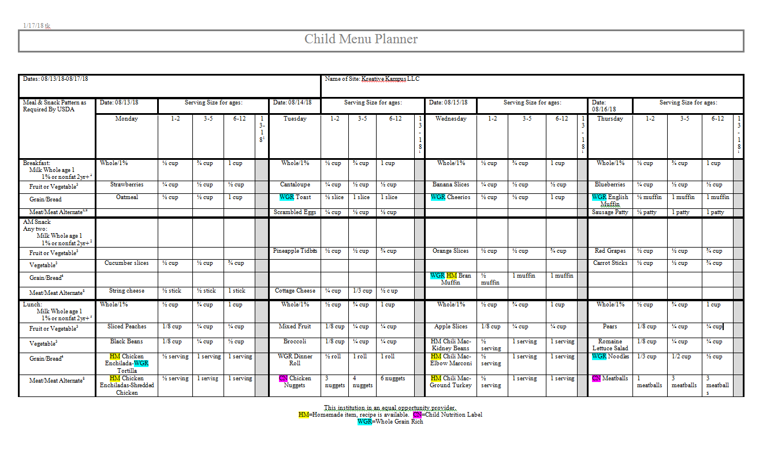
Creating Compliant Menus
Disclaimers
All menus are required to indicate Homemade, CN/Product Formulation, and Whole Grain Rich items.

Slide 10

Creating Compliant Menus
CACFP Cycle Menu
Tab 1: CN Labels
Tab 2: HM Recipes
Tab 3: WGR Labels
Tab 4: Yogurt Labels
Tab 5: Cereal Labels
Keep all required labels in a 3 ring binder by category. This will keep you organized and set you up for a successful review!

Slide 11
Menu Documentation Requirements
HM
WRITTEN RECIPE WITH # SERVINGS AND SERVING SIZES
CN
VALID CN LABEL/PRODUCT FORMULATION SHEET FOR ALL COMMERCIALLY PROCESSED DISHES WITH MORE THAN ONE COMPONENT
WGR
PRODUCT LABEL & METHOD DOCUMENTATION
Cereal
PRODUCT LABEL & NUTRITION FACTS LABEL
Yogurt
PRODUCT LABEL, NUTRITION FACTS LABEL & INGREDIENTS LIST

Slide 12
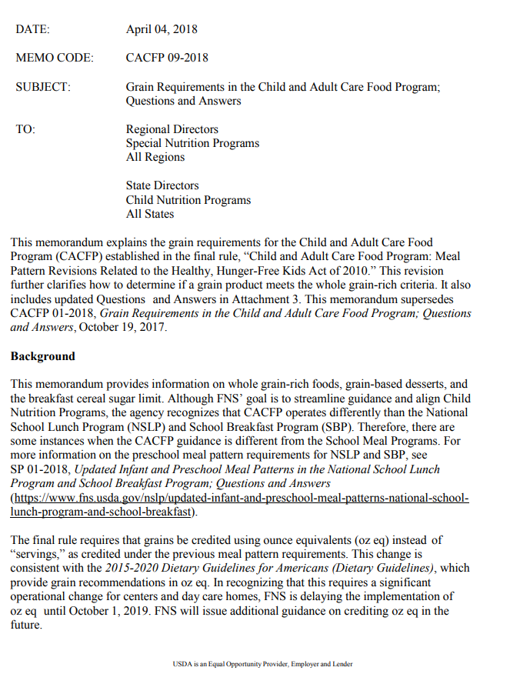
Identifying Whole Grain Rich Items
Memo CACFP 09-2018 provides 6 different ways to identify Whole Grain Rich items

Slide 13
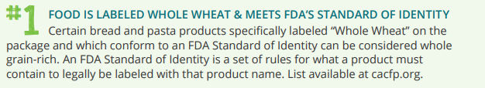

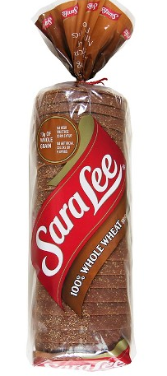
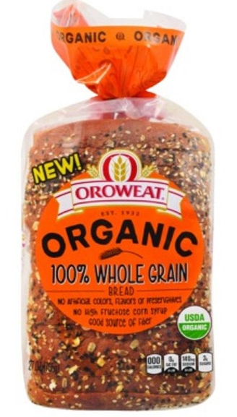
Are these all whole grain rich???

Slide 14
✔

Slide 15

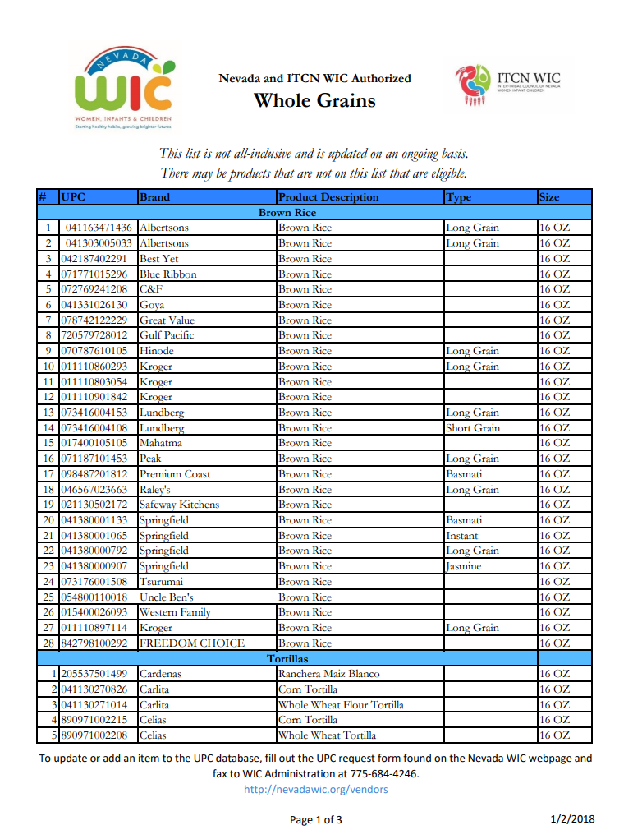
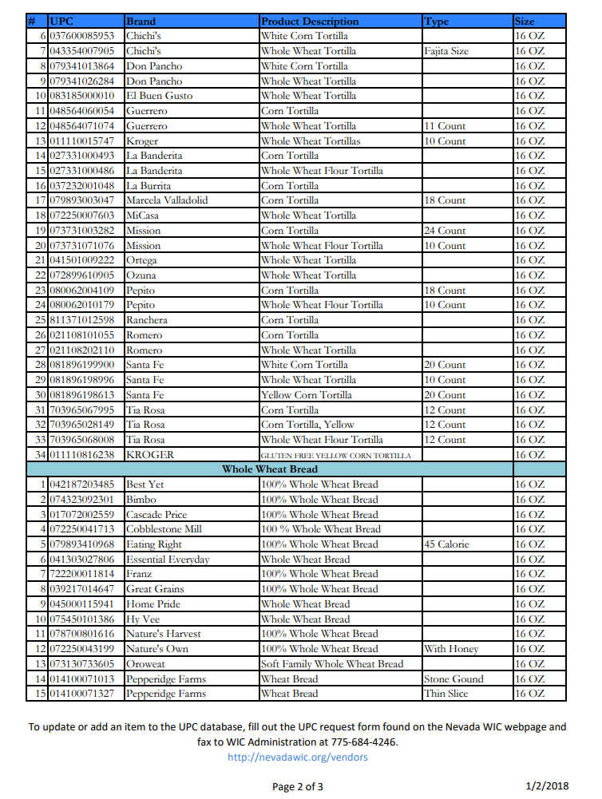
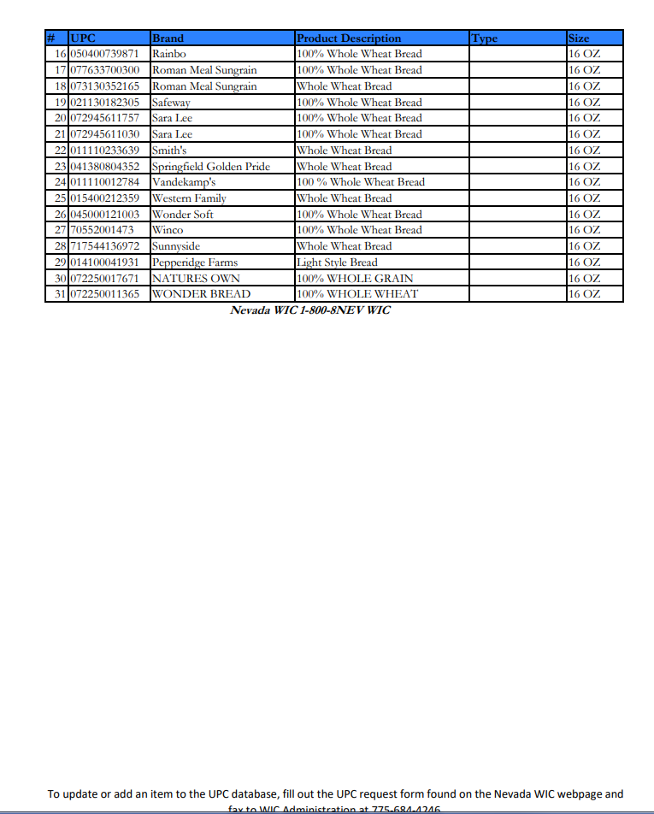
http://nevadawic.org/wp-content/uploads/2018/01/Whole-Grains.pdf

Slide 16



Slide 17
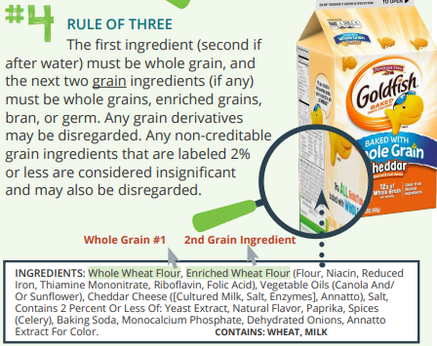
****Disregarded Ingredients may be ignored, as these ingredients are not included in the rule of three**** Other Disregarded Ingredients include; wheat gluten, wheat starch, wheat dextrin, corn starch, corn dextrin, rice starch, tapioca starch, or modified food starch.

Slide 18
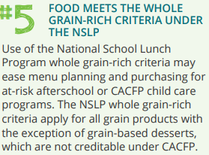

https://www.fns.usda.gov/tn/whole-grain-resource-national-school-lunch-and-school-breakfast-programs-0

Slide 19
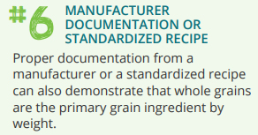
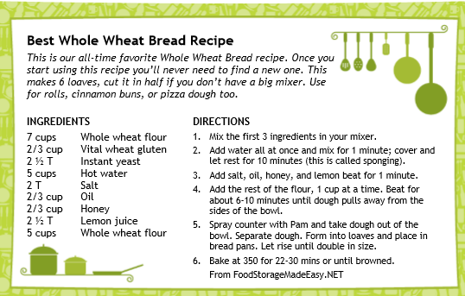
Recipe yields 16-1oz slices per loaf.

Slide 20
Setting You Up For a Successful Review
Maintaining your records is the key to a successful review!
7 CFR 226.15(e): Institutions must establish procedures to collect and maintain all records listed in the CACFP regulations and required by the State Agency. Failure to maintain records will be grounds for the denial of reimbursement for meals lacking records.
7 CFR 226.6(c)(3)(ii)(F): (ii) List of serious deficiencies for participating institutions. The list of serious deficiencies is not identical for each category of institution (new, renewing, participating) because the type of information likely to be available to the State agency is different, depending on whether the State agency is reviewing a new or renewing institution’s application or is conducting a review of a participating institution. Serious deficiencies for participating institutions include: (F) Failure to maintain adequate records.

Slide 21
RECORD RETENTION
USDA requires all hardcopy original CACFP records to be retained for 4 years, current FY and the previous three.
The current month plus the last 12 months of CACFP records must be stored on site.
The previous 3 years of CACFP records may be stored off site; however, they must be made available within a 24 hour notice.
You may maintain electronic copy in addition to hardcopy originals. We encourage you to have a regular scheduled back up system.

Slide 22
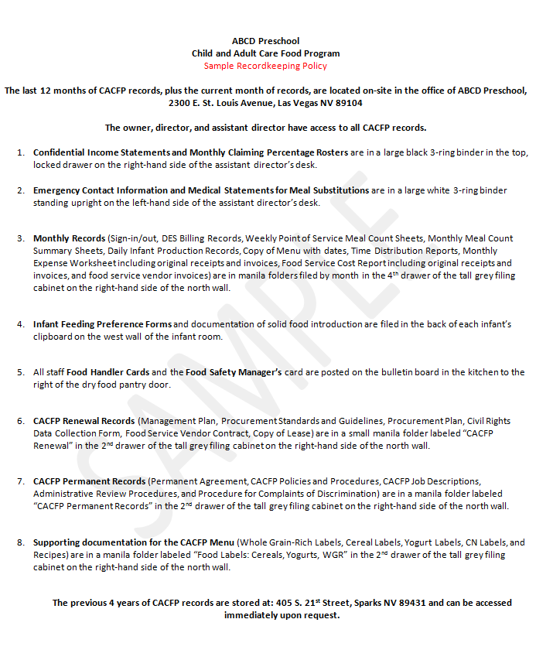
RECORDKEEPING POLICY
Describes exactly where all required CACFP records are stored.
Identifies who has access to records.
Identifies record retention requirements (4 years).
**If records are retained offsite your policy must disclose applicable contract information such as address, storage unit number, etc. and must indicate that all records can be made available to NDA, USDA, Auditors, and any other authorized reviewers within 24 hours notice

Slide 23
ORGANIZING CACFP RECORDS
CACFP RENEWAL APPLICATION
CACFP POLICIES & PROCEDURES
CACFP MONTHLY SUPPORTING DOCUMENTATION
CACFP PERMANENT RECORDS
How Easy Is That?
1 Medium D Ring Binder
Application
Management Plan
1 Medium D Ring Binder
Recordkeeping Policy
Policies & Procedures for Monitoring, Corrective Action, etc.
2-3 Large D Ring Binder & 12 Monthly Hanging File Folders
Binder with Tab Dividers Labeled Free, Reduced, and Above Scale with appropriate claiming rosters and completed Confidential Income Statements
Binders with Emergency Contact Forms and Enrollment Forms
Budget
Supporting documentation
Recent Review
Job Descriptions
Organizational Chart
Monitoring
Current FY Staff Training
Cycle Menus, CN Labels, Recipes, Product Labels, Nutrition Facts, etc.
Food Handlers/Food Safety Manager Certificates, if applicable
Monthly File Folders-Sign in Sheets, Point of Service Meal Counts, Infant Meal Record, Meal Count Summary, Dated Menus with substitutions if necessary, Food Cost Report, Expense Worksheet, Labor Costs/Time Sheets, Sponsor & Site Claims, Supporting Documentation
1 Two Pocket Portfolio Folder
Permanent Agreement
Administrative Review Procedures
Procedures for Complaints of Discrimination
Integrity Statements
Financial Viability documents including independent auditor’s report, and balance sheet.
Vendor Contracts
Outside Employment Policy (for multiple site sponsors only)
Integrity Statements
Board of Directors List
Public Communications
Tiering Documentation, if applicable
Health Inspections
Signed Medical Statements

Slide 24
THE REVIEW PROCESS
CACFP Review
Notified of Finding or Non-compliance
Letter with assigned corrective action and/or fiscal action
Develop Policy & Procedure to permanently correct
Conduct staff training & implement new process
Complete & Submit Corrective Action Plan
Notification of Review Letter
Corrective action is assigned with a due date. Appeal procedures are provided, if fiscal action is required
Sponsor must inform and train responsible staff and ensure an edit check is in place
Finding or noncompliance identified
The on-site checklist is attached with this letter. It provides guidance to what records need to be available for the review
Observations or findings are discussed and technical assistance provided
Sponsor identifies the root cause and develops a solution
Retain copy of on site review/NDA review letter and approved corrective action plan

Slide 25
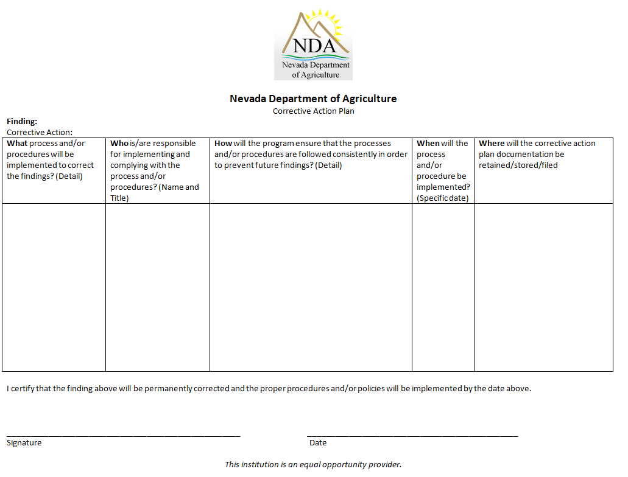
SUBMITTING ACCEPTABLE CORRECTIVE ACTION
For each finding you will complete a corrective action plan. This is a written response identifying how a finding has been permanently corrected.

Slide 26
Procurement

Slide 27
The Purpose of Procurement
Obtain goods and services efficiently and economically
Comply with Federal, State, and local regulations
Prevent fraud, waste, and abuse
Maximize free and open competition

Slide 28
Forecasting asks:
Do you know how much you spend per year on food and supplies for your program?
Do you use a cycle menu?
Do you know how many children are enrolled in your program?
Do you know how much storage space you have?

Slide 29
Methods of Procurement
After you forecast you will need to determine what method to use to make your purchases:
Micro
Does not exceed $10,000
Small
The purchase amount or contract for food only does not exceed $250,000 and for non-food goods and services does not exceed $50,000
Formal
Used for purchases over $250,000 for food and $50,000 for non-food goods and services.

Slide 30
Methods of Procurement
Micro
Distributes your purchases equally among qualified sources.
Small
Obtain quotes from more than once source (develop specifications).
Formal
Must be formally advertised for a contract in accordance with CACFP regulation.
Was the price of the products reasonable?
Price must be the most important factor.
Use if you only want to purchase from one source.
Invitation For Bids and Request For Proposals must be solicited from at least three known suppliers for a sufficient time prior to the date set for opening of bids or scoring of proposals. If only one response, contact NDA for USDA approval.

Slide 31

Civil Rights
Food and Nutrition Service, USDA
Adapted by The Nevada Department of Agriculture August 2019

Slide 32
Sponsor’s Responsibility
No disparity in meal service due to race, color, national origin, age, disability, sex
  Eating periods, Serving lines,
  Seating arrangements, and
  Eating areas must reflect equality!
“Building for the Future” flyer
  Post where visible and readable for all or distribute to parents/guardians.
  Notifies parents/guardians about the CACFP, how to contact the sponsor and NDA, and how to file a civil rights complaint.
Procedure for Language assistance
  Persons with Limited English Proficiency (LEP) (ability to read, speak, write or understand English) may be entitled to language assistance in understanding program services and benefits.
  Determine type of language assistance needed based on highest percentage of national origin(s) population in the area by going to the
“And Justice for All” poster
  Post where visible and readable for all in administrative building and at each site
Reasonable accommodations for persons with disabilities
  see Meal Modifications training
Handling and reporting Civil Rights complaints
  Follow procedures and use the form and log in binder at each site
Include non-discrimination statement on the sponsor website and all program literature that mentions meals/snacks, including posted menus.
Report Racial/Ethnic Participation for each site onto the Data Collection Form. Total all site data and enter onto the Sponsor Application on CNP.

Slide 33
GOALS OF CIVIL RIGHTS
Equal treatment for all applicants and beneficiaries under the law
Knowledge of rights and responsibilities
Elimination of illegal barriers that prevent or deter people from receiving benefits
Dignity and respect for all

Slide 34



FEDERAL FINANCIAL ASSISTANCE
Federal financial assistance is anything of value received from the Federal government and can include cash, commodities, training, excess, computers, and more.
Accepting Federal financial assistance requires compliance with civil rights rules in all aspects of operations – not just in the program being funded!

Slide 35
HELPFUL REFERENCES
USDA Regulations at 7 CFR 15
USDA Regulations at 7 CFR 16
CACFP Regulations at 7 CFR 226.6
FNS Instruction 113-1, including Appendix B

Slide 36

WHAT IS A PROTECTED CLASS ?
Any person or group of people who have characteristics for which discrimination is prohibited based on a law, regulation, or executive order. Protected classes in CACFP are race, color, national origin, age, sex, and disability.

Slide 37
SITUATION
Someone complains that she was denied participation in the CACFP because she is a Muslim. Is this a civil rights violation since religion is not a protected class?

Slide 38
SITUATION-ANSWER
A complaint like this would not be handled as a civil rights matter because there would be no basis for citing a civil rights violation. It would, however, be addressed as a program matter because if true, an inappropriate eligibility criterion dealing with religion was applied which served as a barrier to participation. Any complaints that make allegations that are not related to a protected class are referred to the program to e handled as a customer service issue and/or to determine if program rules were violated.

Slide 39
ASSURANCES
In order to receive Federal funding, agencies/providers must sign assurances that they will abide by civil rights requirements in program delivery
The NDA pre-award compliance review document is used to determine the likelihood of civil rights compliance.

Slide 40

ASSURANCES=PROMISES
No discrimination based on race, color, national origin, age, sex, or disability
Program will be operated in compliance with all nondiscrimination laws, regulations, instructions, policies, and guidelines
Compile data, maintain records, submit reports
Allow reviews & access

Slide 41
SITUATION
Someone who runs a day care center would like to apply for CACFP but doesn’t like the idea of opening up enrollment to everyone because some existing customers distrust people not like themselves. Is this allowed?

Slide 42
SITUATION-ANSWER
No. As long as the day care center accepts Federal financial assistance
for CACFP or from any other source, it cannot discriminate in any aspect of its operations based on race, color, national origin, age, sex, or disability. Other Federal agencies may have additional protected classes.

Slide 43
TYPES OF DISCRIMINATION
Disparate treatment – Because of protected class, someone is treated differently – may sue agency
Disparate Impact - Discriminatory result on a protected class results from action or rule – appeal to Federal agency
Reprisal/Retaliation - Negative treatment due to prior civil rights activity by an individual or his/her family or known associates or for cooperating with an investigation – may sue agency

Slide 44
SITUATION
A sponsor decides to conduct CACFP reviews of all of the day care centers only in a certain zip code. Are there legitimate business reasons for this? Could this be considered discrimination and if so, what kind? Are there other ways of achieve the same result?

Slide 45
SITUATION-ANSWER
There is probably a legitimate business reason such as insuring accountability for doing these audits. By singling out a zip code, however, there might be disparate impact discrimination if the day care homes in that zip code are run primarily by people of the same racial or ethnic group. To overcome charges of
discrimination, the agency would have to demonstrate that there is less discriminatory way of achieving the same objective(s) and that the government interest served by the business reasons outweighs any discrimination that might result. It is important to consider the possible impact of policies before they are implemented.

Slide 46
FAITH AND COMMUNITY BASED ORGANIZATIONS
USDA Regulations at 7 CFR 16 require equal opportunity for Faith Based Organizations (FBO’s) and Community Based Organizations (CBO’s). Conduct outreach to FBOs and CBOs!

Slide 47
FAITH AND COMMUNITY BASED ORGANIZATIONS
Discrimination is prohibited against an organization on the basis of religion, religious belief or character in the distribution of funds
FBOs can use space in their facilities without removing religious art or symbols

Slide 48

FAITH AND COMMUNITY BASED ORGANIZATIONS
Beneficiaries also protected!
No organization that receives direct assistance from the USDA can discriminate against a beneficiary or prospective beneficiary on the basis of religion or religious belief
FBOs retain their independence and carry out their mission, as long as USDA funds or activities do not support worship, religious instruction or proselytization

Slide 49
FAITH AND COMMUNITY BASED ORGANIZATIONS
- EXCEPTION -
7 CFR 16.3 (c) provides that religious organizations that receive USDA assistance under the Richard B. Russell National School Lunch Act, 42 U.S.C. 1751 et seq., the Child Nutrition Act of 1966, 42 U.S.C. 1771 et seq., or USDA international school feeding programs may consider religion in their admissions practices and impose religious attendance or curricular requirements at their schools.

Slide 50
SITUATION
A day care center run by a church and operating the CACFP only admits children who are of the faith served by the church and requires children to say a prayer before the meal. Are there any civil rights problems here and if so, what?

Slide 51
SITUATION-ANSWER
Since CACFP is authorized under the Richard B. Russell National School
Lunch Act, based on the exception in 7 CFR 16.3 (c), there would not be a civil rights problem. Faith based organizations may consider religion in their admissions practices and impose religious attendance.

Slide 52
SITUATION
An atheist complains to you that she was not hired by a church- run day care center because of her lack of religious beliefs. What should you do?

Slide 53
SITUATION-ANSWER
You really do not have to do anything. Religious institutions are exempt from the Title VII provisions that prohibit discrimination based on religion. If the person wants to complain, refer her to the Equal Employment Opportunity Commission (EEOC). We do not investigate employment discrimination complaints unless the behavior directly impact program delivery.

Slide 54
TRAINING REQUIREMENTS
“Frontline staff” who interact with applicants and participants and supervisors of “frontline staff” must be trained annually! This would include day care operators and their staff members.

Slide 55
TRAINING REQUIREMENTS
“ REQUIRED TRAINING TOPICS:
Collection & use of data;
Effective public notification systems;
Complaint procedures;
Compliance review techniques;
Resolution of noncompliance;
Requirements for reasonable accommodation of persons with disabilities;
Requirements for language assistance;
Conflict resolution; and
Customer service

Slide 56
SITUATION
A sponsor develops a computer- based training module for civil rights and wants to distribute it to day care centers to train frontline staff. Is this acceptable?

Slide 57
SITUATION-ANSWER
Yes. FNS Instruction 113-1 allows lots of flexibility in terms of how training is delivered as long as front line staff and their supervisors are trained annually. It is important to track who is trained to make sure the requirement is met. How training is conducted can range from one-on-one briefings to computer based training to classroom presentations and anything in between. It is important to have provisions for make-up sessions for anyone who misses the training. Computer based training is good in that there are ways to build in tracking systems to insure that everyone completes the training. The drawbacks are a lack of interaction including a lack of ability to share situations and to get questions answered on the spot.

Slide 58
DATA COLLECTION & ANALYSIS
Collected to help determine if there are disparities between potentially eligible and participating populations
Allow for targeting of outreach efforts
Aggregated for analysis
Kept confidential

Slide 59
DATA COLLECTION & ANALYSIS
People self declare
All must indicate if Hispanic or Latino or not – mixed must choose ONE
All must indicate one race only
If person refuses to code, advise you will code for them: rationale is discrimination based on perception and others would perceive same as you.
These are government wide requirements imposed by the Office of Management & Budget (OMB)

Slide 60
DATA COLLECTION & ANALYSIS
See Census Quick Facts http://quickfacts.census.gov/qfd/ for info by county for each State
See Census Bureau web site www.census.gov for other data that are available

Slide 61



SITUATION
The parents of a child refuse to complete the racial ethnic data section of the application. What should the day care provider do?

Slide 62
SITUATION-ANSWER
Explain to the parents that if they refuse to code then you or someone else will code for them based on perception. If they still refuse, check off one box for ethnicity (either Hispanic or Latino or Not Hispanic or Latino) and one race. Just as applicants or participants must chose one race, someone coding for someone else should code only one race as well.

Slide 63
PUBLIC NOTIFICATION
Outreach/communication
People need to know about CACFP and know their rights
Underserved populations need special attention and special efforts
Market your program and the fact that it does not discriminate!

Slide 64
PUBLIC NOTIFICATION
Contact community groups & advocacy groups
Display the “And Justice for All…” poster (day care homes are exempt)
Include the required nondiscrimination statement on all appropriate FNS and agency publications, Web sites, posters and informational materials.
Convey the message of equal opportunity in all photos and other graphics that are used to provide program or program-related information.

Slide 65
PUBLIC NOTIFICATION
Special outreach to underserved groups
Use special formats to reach disabled
Use other languages to reach people with limited English proficiency
Be creative! TV, radio, posters, flyers, supermarket bulletin boards, local clubs, libraries, schools, special events, fairs, mailings, Internet, web site links…

Slide 66
SITUATION
The area served by a day care center has a large ethnic community where many of the people have limited English proficiency. What are some public notification techniques that could be used to reach out to this community?

Slide 67
SITUATION-ANSWER
Establishing contacts with community groups and leaders could be a key way to help build trust. These people could also help spread the word about CACFP to members of the community and might even translate information and help with interpreting. In addition, look for ethnic media outlets, especially newspapers and radio. Especially for smaller groups, the newspapers might be out of state or might be national so do not limit yourselves. Use computer search engines to find sources and contacts. Have materials available in the language spoken by the group and be helpful and accommodating. Learn something about the culture and to the extent possible make the day care center friendly to the group.

Slide 68
SITUATION
A day care center wants to move to a bigger space in another part of town. Are there any civil rights or public notification issues possibly connected to this?

Slide 69
SITUATION-ANSWER
There may be civil rights issues if there are groups negatively impacted by the move. This is why it is important to solicit input from the community. Things such as public transportation, parking, and other accessibility issues need to be considered. The new space needs to conform to Americans with Disabilities Act (ADA) guidelines. Make sure modifications are agreed to and guaranteed for completion by a certain date BEFORE you sign a lease.

Slide 70
SITUATION
Since the And Justice for All poster is large and a sponsor wants a smaller version, may sponsors design and print their own posters?

Slide 71
SITUATION-ANSWER
No. Unfortunately, USDA does not allow States to design and print their own posters. States may, however, choose to copy and print the existing AD-475C as long as it is the official 11. wide by 17. long. As soon as new posters become available, FNS will advise State agencies about ordering new supplies. It is important that poster ordering procedures be communicated to local providers. Ideally, this information should be available on the State agency's or sponsor's web site. FNS will refer requesters to State agencies. How to order posters should be included in civil rights training for local providers.

Slide 72
NONDISCRIMINATION STATEMENT
In accordance with Federal civil rights law and U.S. Department of Agriculture (USDA) civil rights regulations and policies, the USDA, its Agencies, offices, and employees, and institutions participating in or administering USDA programs are prohibited from discriminating based on race, color, national origin, sex, disability, age, or reprisal or retaliation for prior civil rights activity in any program or activity conducted or funded by USDA.
Persons with disabilities who require alternative means of communication for program information (e.g. Braille, large print, audiotape, American Sign Language, etc.), should contact the Agency (State or local) where they applied for benefits. Individuals who are deaf, hard of hearing or have speech disabilities may contact USDA through the Federal Relay Service at (800) 877-8339. Additionally, program information may be made available in languages other than English.
To file a program complaint of discrimination, complete the USDA Program Discrimination Complaint Form (AD-3027) found online at: http://www.ascr.usda.gov/complaint_filing_cust.html, and at any USDA office, or write a letter addressed to USDA and provide in the letter all of the information requested in the form. To request a copy of the complaint form, call (866) 632-9992. Submit your completed form or letter to USDA by: (1) mail: U.S. Department of Agriculture, Office of the Assistant Secretary for Civil Rights, 1400 Independence Avenue, SW, Washington, D.C. 20250-9410; (2) fax: (202) 690-7442; or (3) email: program.intake@usda.gov.
This institution is an equal opportunity provider.

Slide 73
NONDISCRIMINATION STATEMENT
SHORT VERSION:
“This institution is an equal opportunity provider.”
May be used in small flyers or brochures where the longer statement does not fit.
Must be in font size no smaller than font size used in rest of publication
Should not be used where information on rights is provided.

Slide 74
NONDISCRIMINATION STATEMENT
WEB SITES
Include the long statement or a link to it on web sites that discuss FNS funded programs. Home page at a minimum!
Include the long or short statement on materials intended to be printed off the web site.

Slide 75

SITUATION
A CACFP site prints an informational brochure in another language. Since the nondiscrimination statement is very technical and the population is not well educated, it is felt there is no need to include it. It would also take up too much space. Is this correct?

Slide 76
SITUATION-ANSWER
No. The nondiscrimination statement must be on all materials and sources used to inform the public about FNS funded programs such as the CACFP. The nondiscrimination statement would need to be translated into the language used on the brochure. Keep in mind that the short statement may be used if there is no room for the longer statement, but the short statement must be in a font size no smaller that the font used in the rest of the publication. Also, avoid using the short statement on any materials that provide a comprehensive overview of the program or that are intended to advise people about their rights and responsibilities related to the program.

Slide 77
COMPLAINT PROCEDURES
To file a program complaint of discrimination, complete the USDA Program Discrimination Complaint Form (AD-3027) found online at: http://www.ascr.usda.gov/complaint_filing_cust.html, and at any USDA office, or write a letter addressed to USDA and provide in the letter all of the information requested in the form. To request a copy of the complaint form, call (866) 632-9992. Submit your completed form or letter to USDA by: (1) mail: U.S. Department of Agriculture, Office of the Assistant Secretary for Civil Rights, 1400 Independence Avenue, SW, Washington, D.C. 20250-9410; (2) fax: (202) 690-7442; or (3) email: program.intake@usda.gov.
This institution is an equal opportunity provider.

Slide 78
COMPLAINT PROCEDURES
Be aware of the bases for which complaints may be filed: race, color, national origin, age, sex, and disability
Never discourage groups or individuals from filing complaints or from voicing allegations of discrimination.
Keep Complaint Procedures in a binder at each site.
FNS Instruction 113-1 outlines complaint investigation procedures.

Slide 79
SITUATION
A parent who is a chronic complainer is now threatening to file a discrimination complaint because you put her child in the “naughty nook” for misbehaving. What should you do?

Slide 80
SITUATION-ANSWER
If you have procedures for discipline, show them to the parent and make sure you apply the procedures consistently so that children of one race, sex, or national origin are not singled out for punishments for actions where other children are not punished when they do the same thing. Under no circumstances should you try to deter the parent from filing a complaint. Instead, provide the parent with information on how to file a complaint.

Slide 81
COMPLIANCE REVIEWS
Pre-award, post-award, and special
Check for non-discrimination and insure civil rights requirements being followed
Conducted by State or Federal staff or both

Slide 82
RESOLUTION OF NONCOMPLIANCE
CORRECTIVE ACTIONS:
Cease inappropriate actions
Institute appropriate procedures
FAILURE/REFUSAL CAN RESULT IN LOSS OF FEDERAL ASSISTANCE FROM ALL FEDERAL SOURCES!

Slide 83
REASONABLE ACCOMMODATIONS
INSURE ACCESS FOR PEOPLE WITH DISABILITIES!
Parking lot, entrances & exits, halls, elevators, rest rooms, sign language interpreters, Braille signage, service animals
Alternative arrangements for service

Slide 84
REASONABLE ACCOMMODATIONS
FOOD ACCOMMODATIONS
Accommodations will need to be tailored to meet individual situations
Refer to Meal Modifications training for helpful info

Slide 85
REASONABLE ACCOMMODATIONS
Food Accommodations – Basic Requirements
Medical Statement to Request Special Meals and/or Accommodations – Form in CNP in Meal Pattern folder
Type of disability or medical condition
Type of accommodation needed
Do not second guess doctor
May need to work with a
nutritionist

Slide 86
SITUATION
A parent wants to enroll a disabled child in a day care center. The day care center asks if it can refuse the child admission because it would be too hard to deal with this. What do you respond?

Slide 87
SITUATION-ANSWER
As a rule, except for religious institutions, child care providers may not discriminate against disabled children in enrollment. The Department of Justice has issued extensive guidance on this in the form of Q&A.s that are part of the handouts from this session.

Slide 88
LANGUAGE ASSISTANCE
People with limited English proficiency (LEP) need to be served in other languages
Outreach in other languages is important
Generally, service must be provided – flexibility in how it is provided

Slide 89
LANGUAGE ASSISTANCE
How service is provided depends on:
number & proportion of LEP persons served or encountered in eligible population;
frequency of LEP persons’ contact with program;
nature & importance of program, activity, or service; and
resources available and costs.
SHORTAGE OF RESOURCES DOES NOT ELIMINATE REQUIREMENT EXCEPT IN CASES OF EXTREME HARDSHIP!!!

Slide 90
LANGUAGE ASSISTANCE
Volunteers may be used, but make sure they understand interpreter ethics – particularly confidentiality!
Children should not be used as interpreters.
See www.lep.gov for resources & information.

Slide 91
SITUATION
A reputable charitable organization in your community wants to provide holiday gifts and asks for a list of all of the Hispanic children being served by your organization. How should you respond?

Slide 92
SITUATION-ANSWER
Under no circumstances should the charitable organization, no matter how reputable, be provided with names. First, it would violate privacy and requirements relating to confidentiality of racial/ethnic data. Also, by singling out Hispanic children to receive gifts, this organization is seeking to violate Title VI by discriminating based on national origin since this would impact negatively on other children. By identifying the Hispanic children, the provider would be facilitating discrimination.

Slide 93

CONFLICT RESOLUTION
Have a written and posted policy for dealing with unacceptable behavior and conflicts
Try to remain calm
Try to explain situation
Get help, especially if threats or if violence is possible
Use alternative dispute resolution (ADR) techniques

Slide 94
CUSTOMER SERVICE
“Treat others the way they want to be treated
(or at least be aware of what that is).”
Be patient.
Be polite.
Avoid sarcasm.
Be empathetic. Understand that people may not know the rules or understand how programs work. They may feel uncomfortable coming to ask for help.
Smile when appropriate – make people feel welcome and valued.
Explain policy and let them know you will get in trouble if you do anything that violates the rules.
Don’t be afraid to apologize.
Don’t feel you need to have the last word.

Slide 95
QUESTIONS?
Contact:
Nevada Department of Agriculture
702-668-4585

Slide 96
KNOWLEDGE TEST
Submit your answers with the signed Certification Statement

Slide 97
Where can the Monthly Expense Worksheet and Food Cost Report be found on CNP Web under Sponsor Resources?
A) Claim B) Financial
C) Information D) Compliance Packet
2) How may ways can you determine Whole Grain Items?
A) 2 B) 10
C) 6 D) 1
3) Menus must indicate which items are Whole Grain Rich, Homemade, and have CN Labels and/or Product Formulation Sheets?
A) True B) False
4) Point of Service is done ______________.
A) After the meal, based on attendance B) Once the participants are served the reimbursable meal/snack
C) At the end of the day D) After the meal, ask the cook how many meals were served
5) What type of milk is creditable for a two year old?
A) Whole B) 2%
C) 1% C) Fat-Free Chocolate
6) A Breakfast menu consists of Oatmeal and Milk, is this a reimbursable meal?
A) Yes B) No
7) Where should signed Medical Statements be stored
A) Permanent Documents B) CACFP Monthly Records
C) Renewal Documents C) All of the Above
8) A parent would like to bring their child's milk and fruit component for lunch everyday, would you still be able to claim this child?
A) Yes B) No
9) The CACFP 101-Administrative Track would be best for ___________?
A) Designated Officials B) Teachers
C) Day Care Home Providers D) Parents
10) The Point of Service Meal Count Sheets need to be signed by _____________.
A) They don’t need signed B) The owner
B) The person taking the POS C) The bus driver

Slide 98
Certification
I, ___________________________, certify that I have completed the Annual Renewal and Civil Rights Requirements training contained in this Power Point presentation.
I further certify to ensure that civil rights is properly implemented at all sites that are a part of the CACFP program.
Signature______________________________
Name______________________________
Title_______________________________
Organization__________________________
Date _________________
Email this signed statement to Vickie Guy at vguy@agri.nv.gov

